Slide 1
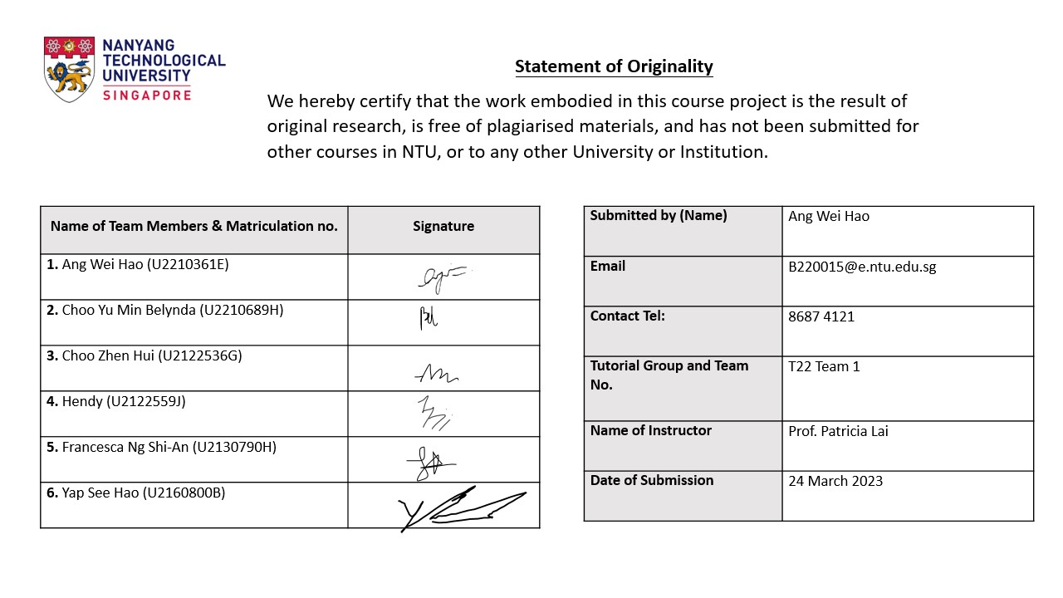

Slide 2
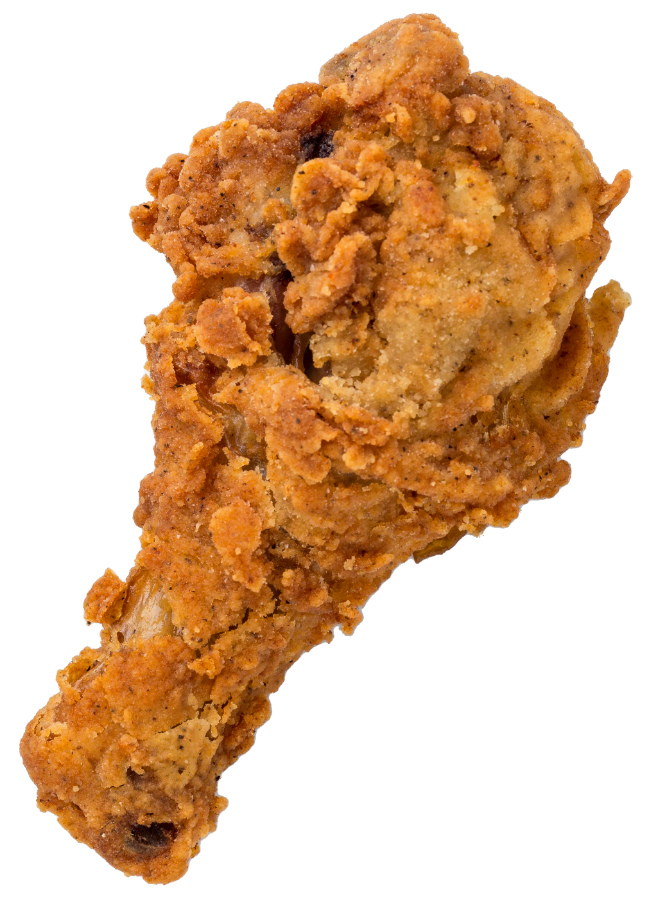
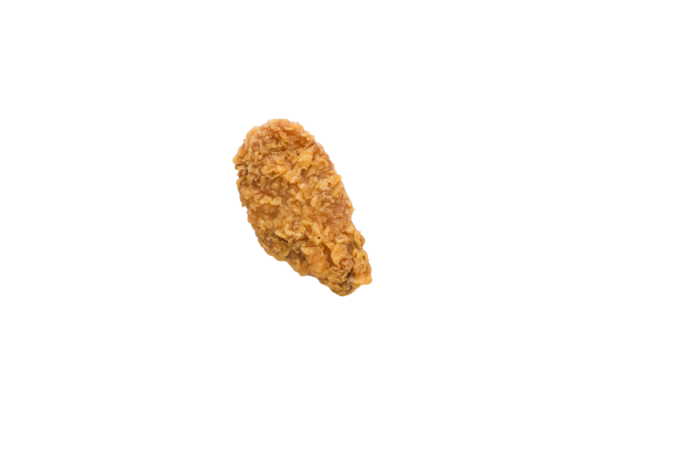
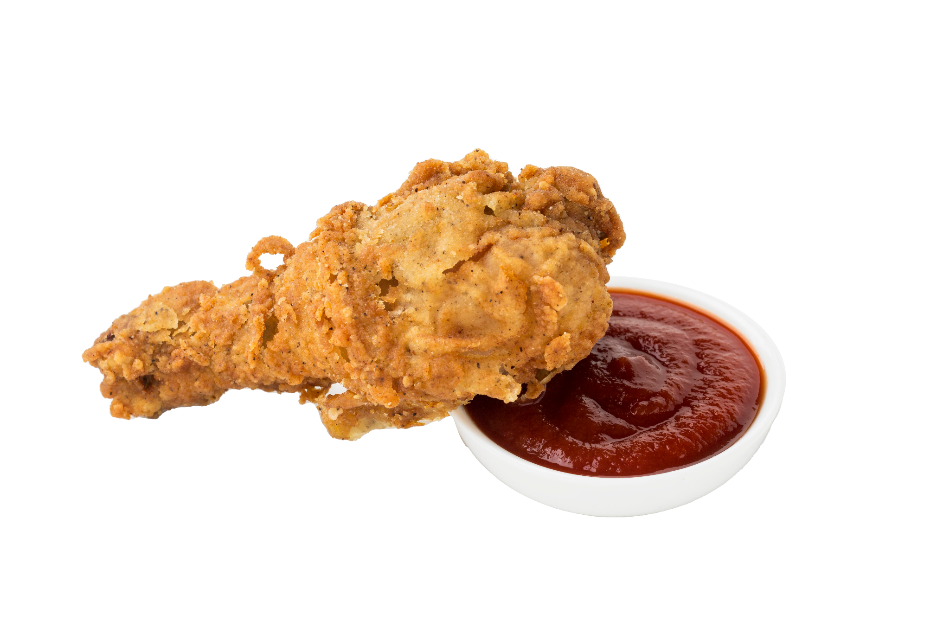
More Batter?
More Better!
Tutorial Group 22, Team 1
Ang Wei Hao (U2210361E)
Choo Yu Min Belynda (U2210689H)
Choo Zhen Hui (U2122536G)
Hendy (U2122559J)
Francesca Ng Shi-An (U2130790H)
Yap See Hao (U2160800B)

Slide 3
Gains
Incentives to try More Batter fried chicken
Excitement of trying a new trend and fried chicken flavour
A recognisable brand icon that can be easily identified
A unique brand experience, one that goes beyond the food and is interactive and informative
Pains
More Batter’s fried chicken is expensive
Hesitancy to try as the brand is relatively unknown
Lack of differentiation that deters customers from returning
Customers do not see the value of an e-commerce brand
Target Customers
Young Singaporean Adults
(Aged 19 to 30 years old)
Tertiary students (Aged 19 to 25 years old)
Young working adults (Aged 25 to 30 years old)
Competitor Analysis
Drawing inspiration from three close competitions: Wingstop, 4Fingers, and KFC. We concluded that a combination of unique flavours, predictability, good value, and evoking curiosity is critical in brands’ longevity and success.
Value Proposition
To provide an “all-in-one” sensory gastronomical experience worth every dollar, where customers will get to learn and play beyond enjoying fried chicken.
Solutions
New fried chicken sets
Launch of new Thai season
Maurice, the More Batter chicken
The Gastronomical Experience
Do Batter
Collaboration with TheSmartLocal and Eatbook
Planning of key distribution points
“Where to next?” Instagram poll
Notes:
Executive Summary
More Batter is a relatively new brand. Soft-launched in September 2022, it is largely unheard of among Singaporeans. According to our survey of 36 respondents, 77.8% have never heard of the brand, while 19.4% have heard of the brand, but have not tried it yet. With this, there is a need for us to raise awareness of More Batter and onboard new customers before they set off on their customer journey.
As customers of More Batter, some of the gains they will be entitled to are:
Incentives to try More Batter fried chicken
Excitement of trying a new trendy and fried chicken flavour
A recognisable brand icon that can be easily identified
A unique brand experience, one that goes beyond the food and is interactive and informative
At the same time, we recognise some of the pains they have:
More Batter’s fried chicken is on the steeper side
Hesitancy to try as the brand is relatively unknown
Lack of differentiation that deters them from returning
They do not see the value of an e-commerce brand
We will be targeting young Singaporean adults (aged 19 to 29 years old) for our marketing campaign. This target group will be further divided into tertiary students (aged 19 to 25 years old) and young working adults (aged 25 to 29 years old).
A competitor analysis was conducted on three close competitors - Wingstop, 4Fingers, and KFC. We concluded that More Batter can draw inspiration from these competitors in four key areas - Unique Flavours, Predictability, Value for Money, and Evoking Curiosity.
Our value proposition is to provide an “all-in-one” sensory gastronomical experience worth every dollar, where customers will get to learn and play beyond enjoying fried chicken. As such, we have devised several solutions centered around this, including:
New fried chicken sets for greater flexibility of choice
The launch of a new Thai season, with cuisine-inspired flavours and sides to complement
A new mascot, aptly named “Maurice, the More Batter Chicken”
“The Gastronomical Experience”, a physical marketing campaign
“Do Batter”, a TikTok challenge
Collaboration with TheSmartLocal and Eatbook
Planning of key distribution points
“Where to next?”, an Instagram poll to gather feedback for the next season and conclude the marketing campaign

Slide 4
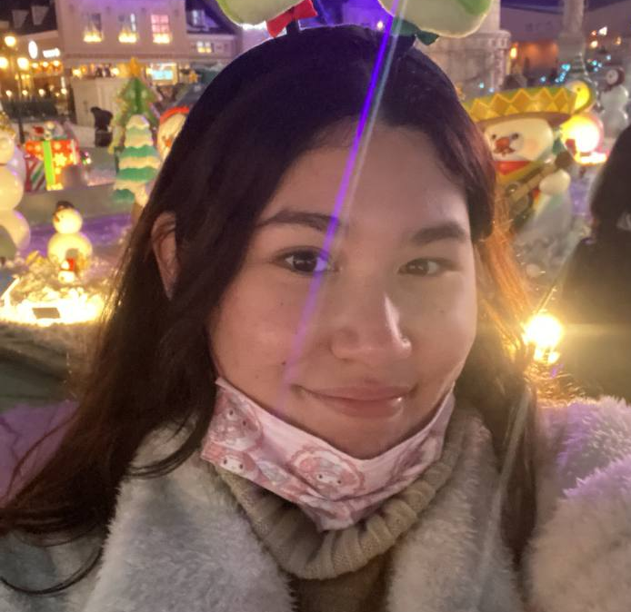
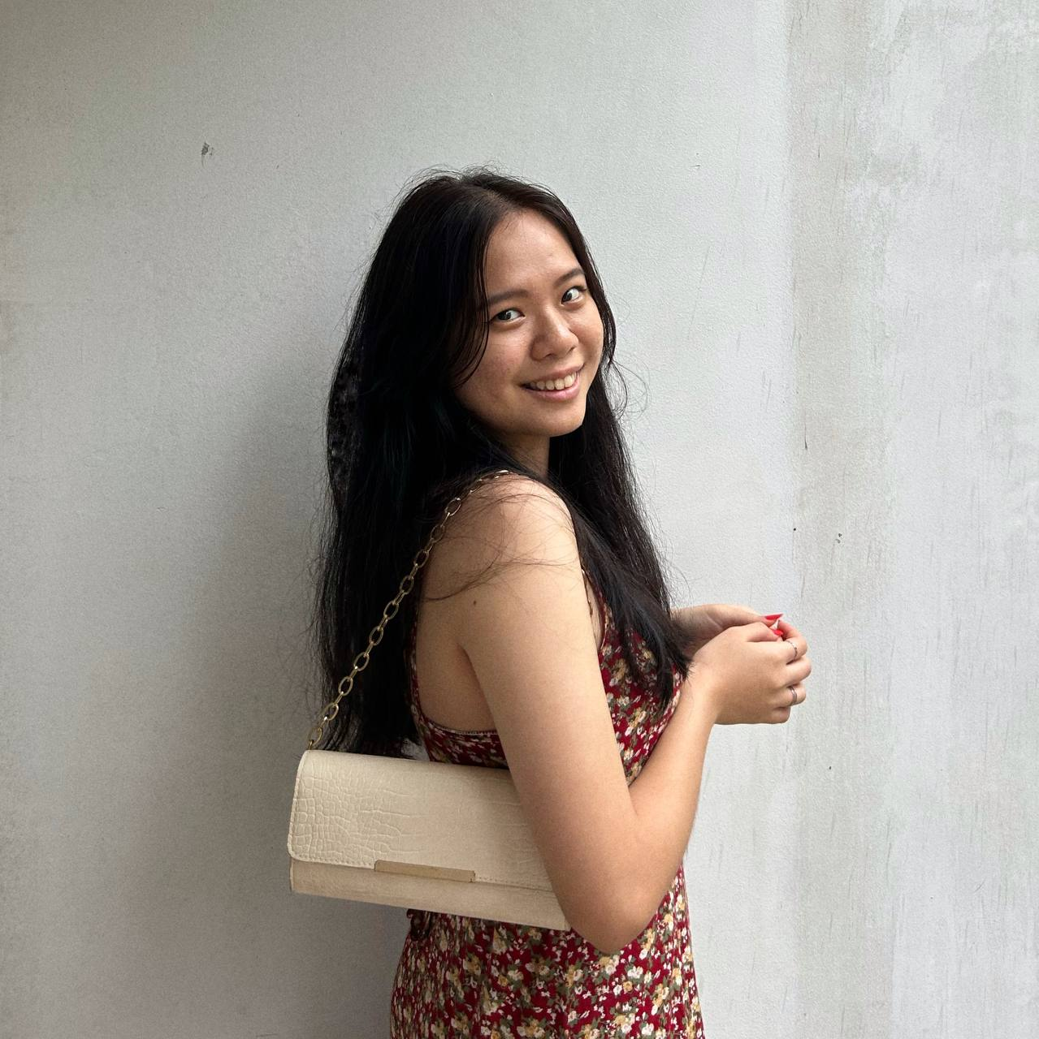
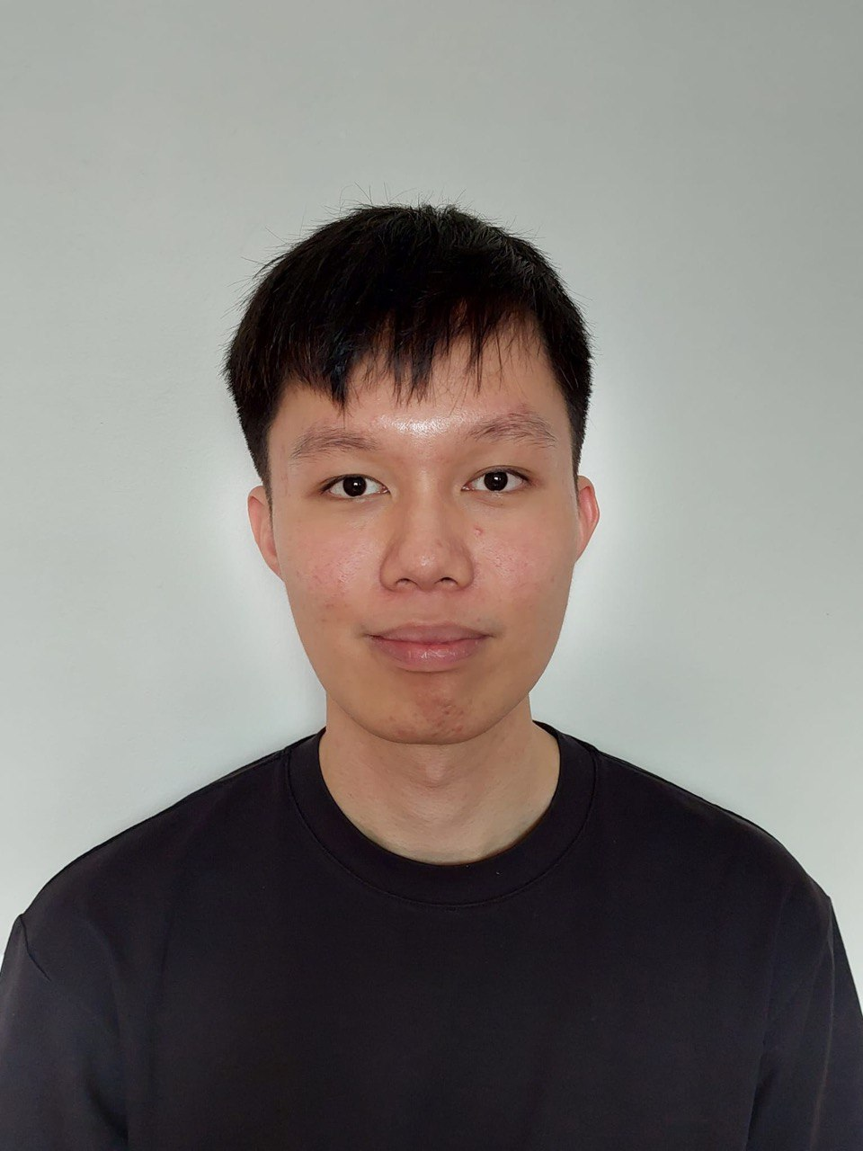
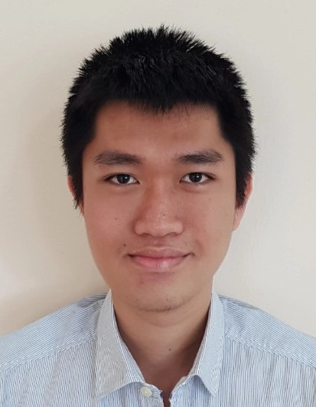
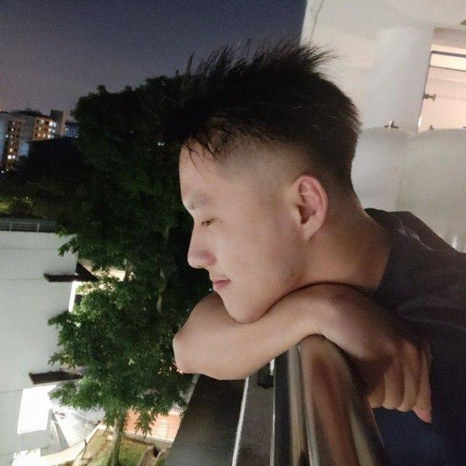
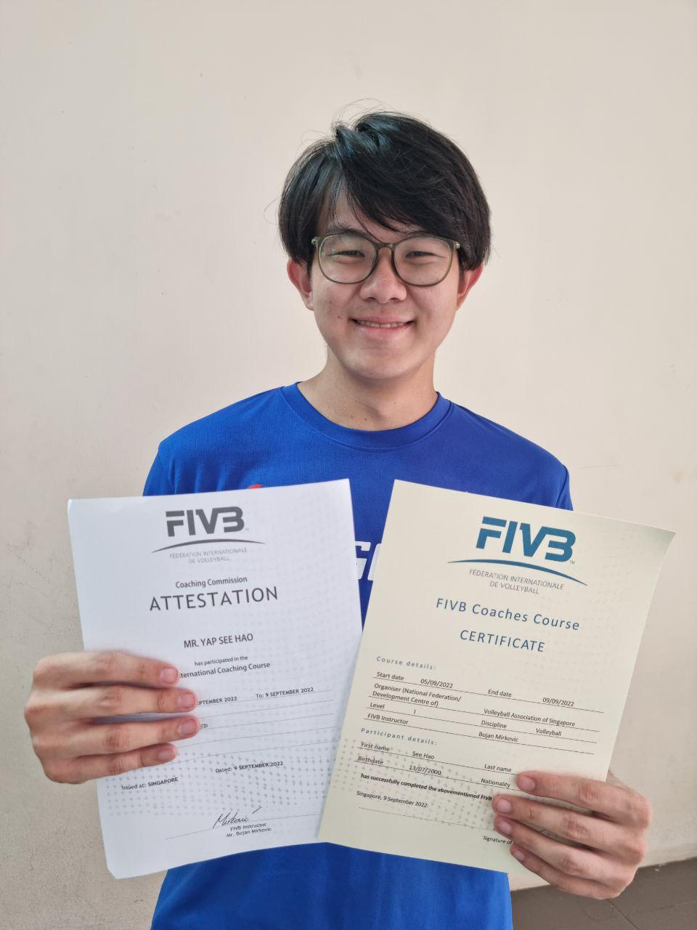
Introducing Our Team!
Francesca Ng
Year 2 Sociology
Belynda Choo
Year 1 Business
Ang Wei Hao
Year 1 Business
Choo Zhen Hui
Year 2 Computer Science
Hendy
Year 2 Computer Science
Yap See Hao
Year 2 Sports Science & Management

Slide 5
Customer Journey Timeline
Selection of desired flavours and sets
Placing the order
Frequent
Customer
1
2
3
4
5
Going onto food delivery platforms
Selection of applicable discounts (if any)
Food is delivered and consumed
Going onto More Batter website or major delivery platforms
Placing the order
New
Customer
1
2
3
4
5
Gaining awareness of the brand
Selection of desired flavours and sets
Food is delivered and consumed
Notes:
Here is the customer journey timeline. In order to understand the pains and gains that each customer might have, we have decided to look at it from the customer’s point of view. The customer journey is split into two parts: frequent customers and new customers.
Frequent Customers
Since the frequent customer is aware of the brand, he/she would already know the available fried chicken flavours and sets, where to go to place an order, and how to collect their food.
The first step would be going onto food delivery platforms such as GrabFood, FoodPanda, Deliveroo, or Oddle to start ordering.
The second step would be to select the desired fried chicken flavours and sets.
The third step would be to select applicable discounts. Applicable discounts could include menu discounts, free delivery, or gift vouchers.
The fourth step is confirming and submitting the order.
The last step is the food being delivered to the customer, or the customer visiting the various pick-up points (https://morebatter.com.sg/#order) to collect their order. The fried chicken would then be consumed.
New Customers
New customers experience the exact same journey as frequent customers. However, there are two main differences - One, the new customer is unfamiliar about the process, and it might take more time for him/her to go through the process. Two, the new customer needs to first be aware of the brand. Hence, this will be the journey for new customers.
The first step would be gaining awareness of the brand. This is where our marketing campaign would come in to increase brand recognition for these new customers.
The second step would be going onto the More Batter website to view the available fried chicken flavours and sets, where to go to place an order, and how to collect their food. They would then go onto food delivery platforms such as GrabFood, FoodPanda, Deliveroo, or Oddle to start ordering.
The third step would be to select the desired fried chicken flavours and sets. Since they are new to More Batter, it is unlikely that they would be aware of any menu discounts, free delivery, or gift vouchers.
The fourth step is confirming and submitting the order.
The last step is the food being delivered to the customer, or the customer visiting the various pick-up points (https://morebatter.com.sg/#order) to collect their order. The fried chicken would then be consumed.

Slide 6
Gains
1
2
Excitement
Incentives
of trying a new trend / fried chicken flavour
to try More Batter fried chicken
Unique brand experience
4
3
Recognisable Brand Icon
that goes beyond the food (Interactive and informative)
that customers can identify with
Notes:
Here are customers’ gain and pains.
Gains show the benefits that customers expect and need, what would delight them, and factors which may increase our value proposition. On the other hand,
Pains show the negative experiences, emotions, and risks that customers may experience throughout the customer journey.
To achieve our objective of providing an effective solution to deliver good value to customers (In terms of Price and Quality – Food/Service), our team analyses the customer profile through the pains and gains in their journey.
From the customers’ perspective, the gains that customers expect are:
Getting incentives in exchange for trying the food, such as menu discounts, free delivery, gift vouchers, etc. Customers seek products and services that offer good value for their money. (Refer to Survey Results in Annex - Most customers are only willing to pay lower price ranges for More Batter’s products.)
Excitement of trying a new trend and flavour that is different from other fried chicken. More than just eating fried chicken, customers expect an element of surprise from the business itself. They are curious to try new things and tend to enjoy experimenting with products that are currently popular. (Refer to Customer Profiles)
Having a recognisable brand icon that can be easily identified. This serves as an important connection that the customers have with the business. A memorable and recognisable brand identity can evoke positive emotions and feelings, which can help to build brand loyalty.
Enjoy a unique brand experience, as More Batter goes beyond the food to provide an interactive and informative experience. Customers seeks positive and memorable experiences with the brand, and will stand to enjoy innovative marketing campaigns and perks provided by More Batter.

Slide 7
Pains
1
2
Expensive
Hesitant to try
price of fried chicken
as brand is relatively unknown
4
3
Do not see value
Lack of differentiation
of an e-commerce brand
Customers are not convinced to return
Notes:
From the customers’ perspective, the pains that customers experience are:
Comparing the price of More Batter’s fried chicken to that of its competitors, the price of More Batter’s fried chicken is much more expensive. (Refer to Survey Results in Annex - Most customers are only willing to pay lower price ranges for More Batter’s products.)
Hesitancy to try More Batter’s fried chicken. The reason for this stems from apprehensiveness and a lack of trust as they have limited exposure to the brand. Customers may fear that More Batter’s fried chicken would not meet their expectations, or that it would be a waste of money. (Refer to Survey Results in Annex - 77.8% of customers have never heard of the More Batter brand. 19.4% of customers have heard of the brand, but have not tried it yet.)
Lack of differentiation from the brand that deters customers from returning after their initial try. The fried chicken does not stand out from competitors and does not offer any unique features or benefits, which lead to customers failing to see a reason to leave their current brand to support a newer brand. (Refer to Customer Profiles and Survey Results in Annex - Feedback on reasons why customers are not keen to try More Batter.)
Customers do not see the value of an e-commerce brand, which can be attributed to a lack of personal touch that customers would otherwise experience in a physical store. (Refer to Survey Results in Annex - Feedback on reasons why customers are not keen to try More Batter.)

Slide 8
Impact on Customers and Business
Missed Opportunity due to Unfamiliarity
Lack of Innovation for Food Flavours/Trends
Unmet Need/Gap
Lack of Fresh New Flavours
Lack of “All-In-One” Experience
Hesitancy to try out new brand and tendency to stick to something familiar
Missed opportunity to discover new fried chicken options
Lack of innovation from the brand to attract customers resulting in customer dissatisfaction
Failure to establish connection between customers and the brand
Market competitors have little variety of flavours to choose from
Lack of flavours discourage customers from coming back again
Market competitors are focused on providing food to customers
Providing an experience that goes beyond the food helps to attract customers
Notes:
As such, there is an impact on both customers and the business.
Missed opportunity due to unfamiliarity
Customers may miss out on the opportunity to try out new flavour options, choosing to stick to familiar brands, hence limiting their fried chicken experience. More Batter may not get the chance to prove itself and gain loyal customers if customers are not willing to try it. This can lead to missed opportunities for both the business and the customers.
Lack of innovation for food flavours/trends The lack of innovation from the brand to attract customers will result in customers feeling detached from the brand, hindering opportunities for customers to connect with the brand and preventing More Batter from growing its brand loyalty.
Thus, there is an unmet need and gap in the market when it comes to fried chicken.
Lack of fresh new flavours
The current market competitors do not provide a wide variety of flavours to choose from, nor do they have a constant rotation of flavours. For instance,
KFC - only offers original recipe and hot & crispy
4Fingers - only offers honey mustard, hot sauce, and soy garlic
Having a limited variety of flavours to choose from will discourage customers from returning. Customers would just try once for the novelty and not return anymore as they have already tried it.
Lack of “all-in-one” experience
The current market competitors are only focused on providing food to customers. There is nothing wrong with that inherently as the main job of a food brand like KFC and 4Fingers is to ensure that food provided are of a certain quality. However, providing an experience that goes beyond just the food through user-generated content or events etc. will help to attract customers.

Slide 9


Young Singaporean Adults
19 to 29 years old
Tertiary Students
19 to 25 years old
Young Working Adults
25 to 29 years old
Mostly study at NUS, NTU, and SMU (MOE, 2022)
Presence on social media platforms such as Instagram, YouTube, and TikTok (MapleTree Media, n.d. and Commission Factory, 2023)
Adventurous to try new flavours
Tend to hop onto the bandwagon
193,000 employed (SingStat, 2022)
Higher income and higher purchasing power (WorkClass, 2023)
Mostly work at the Downtown Core, Queenstown, Geylang, Bukit Merah, and Tampines (SingStat, 2020)
Notes:
Our main target customer group will be young Singaporean adults, aged 19 to 29 years old. We will further segregate the main target group into two distinct groups.
Tertiary Students (aged 19 to 25 years old)
In 2022, the Ministry of Education (MOE) reported a total of 78,945 tertiary students enrolled in university in 2021. The National University of Singapore (NUS) had the highest enrolment, with a total of 31,191 students. This was closely followed by Nanyang Technological University (NTU) with a total of 24,074 students, and Singapore Management University (SMU) with a total of 9,580 students (Ministry of Education, 2022, p. 63). This shows that there is a substantial market size to tap on for this segment for More Batter. With NUS and NTU situated in the West region (NUS located at Clementi and NTU located at Boon Lay) and SMU situated in the Central region (located at City Hall), we can concentrate our marketing campaigns and distribution points in shopping malls located close to the universities to attract more customers from the tertiary students demographic.
Social media platforms such as Instagram, and video-sharing platforms such as YouTube and TikTok are most popular among Singapore’s adolescent population. According to MapleTree, 85% of Instagram users in Singapore are aged between 16-24 years old (MapleTree Media, n.d.). In addition, 9 out of 10 YouTube users are aged between 16-34 years old, while it is projected that 41% of TikTok users are aged between 16-34 years old (Commission Factory, 2023). As such, we can tap on these tech-savvy tertiary students to create user-generated content on popular social media platforms to promote our brand.
Characteristics of tertiary students include being adventurous to try unique flavours and being followers of new trends. These are further backed up by our interviews conducted on our target customers (Refer to the next slide on Customer Profiles).
Young Working Adults (aged 25 to 29 years old)
According to the Singapore Department of Statistics, there are 193,000 Singaporean working adults aged 25 to 29 years old (8.21%), out of a total of 2,350,400, who are employed as of 2022 (Singapore Department of Statistics, 2022). Hence, there is a substantial market size to tap on for this segment for More Batter.
This group of young working adults earn a higher income than their younger counterparts. According to Workclass, Singaporean young working adults aged 25-29 have an average monthly gross income of $3,500 (compared to $2,329 for those aged 20-24, and $1,000 for those aged 15-19) (Rahmad, 2023). This shows that they have greater financial capability and a higher purchasing power to be able to spend on the relatively expensive boneless fried chicken.
Furthermore, the majority of Singaporean working adults (aged 15 and above surveyed) work at the Central Business District, the Downtown Core (12.9%). This is closely followed by Queenstown (6.0%), Geylang (5.3%), Bukit Merah (4.7%), and Tampines (3.8%) (Singapore Department of Statistics, 2020, p. 27). This means that during lunch breaks and after work, young working adults would likely shop and dine at the nearby shopping malls in these districts. As such, we can concentrate our marketing campaigns and distribution points in shopping malls located within or near these districts to attract more customers from the young working adults demographic.
Ministry of Education. (2022) Education Statistics Digest 2022. https://www.moe.gov.sg/-/media/files/about-us/education-statistics-digest-2022.ashx
MapleTree Media. (n.d.) Singapore Social Media Statistics You Should Know Of. https://mapletreemedia.com/singapore-social-media-statistic/
Commission Factory. (2023) Singapore Social Media Statistics and Facts 2023. https://blog.commissionfactory.com/affiliate-marketing/singapore-social-media-statistics
Singapore Department of Statistics (2022). Total Residents Aged 15 Years And Over By Labour Force Status And Age Group, End June. https://tablebuilder.singstat.gov.sg/table/TS/M182091
Rahmad (2023). Average Salary in Singapore by Age, Experience and Education Level. Workclass. https://workclass.co/singapore/blogs/average-salary-in-singapore-by-age-and-experience/
Singapore Department of Statistics (2020). Census of Population 2020 Statistical Release 2: Households, Geographic Distribution, Transport and Difficulty in Basic Activities. https://www.parliament.gov.sg/docs/default-source/default-document-library/cop2020sr2.pdf

Slide 10


Customer Profiles
SASHA
Female, 21
University Student
EUGENE
Male, 29
Air Force Pilot
Personality
Easy-going, Meticulous, Demure
Identifiers
Constantly looking out for good deals & discounts, Enjoys trying new food, Keeps track of food trends, Willing to spend more on delicious food
Fried Chicken Routine
Eats fried chicken at least once every 2 months, as it is convenient
Feedback
Chicken is not well-marinated, Some chicken parts especially breast meat tend to be dry, Lack of interesting variety
Personality
Outspoken, Organised, Reliable
Identifiers
Often posts stories on IG, Enjoys eating good food
Fried Chicken Routine
Rarely eats fried chicken, but usually patronises Korean chicken brands
Feedback
Skin is rarely crispy after some time, Insufficient seasoning, Not tender, Difficult to eat with hands dirty, Prefers spicier food
Notes:
Here are two profiles from each customer segment that we have interviewed.
Sasha
Email: sashalim@gmail.com
Eugene
Email: eugenelow@gmail.com

Slide 11


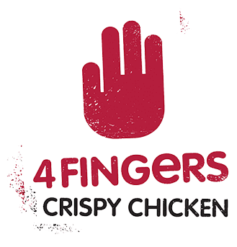
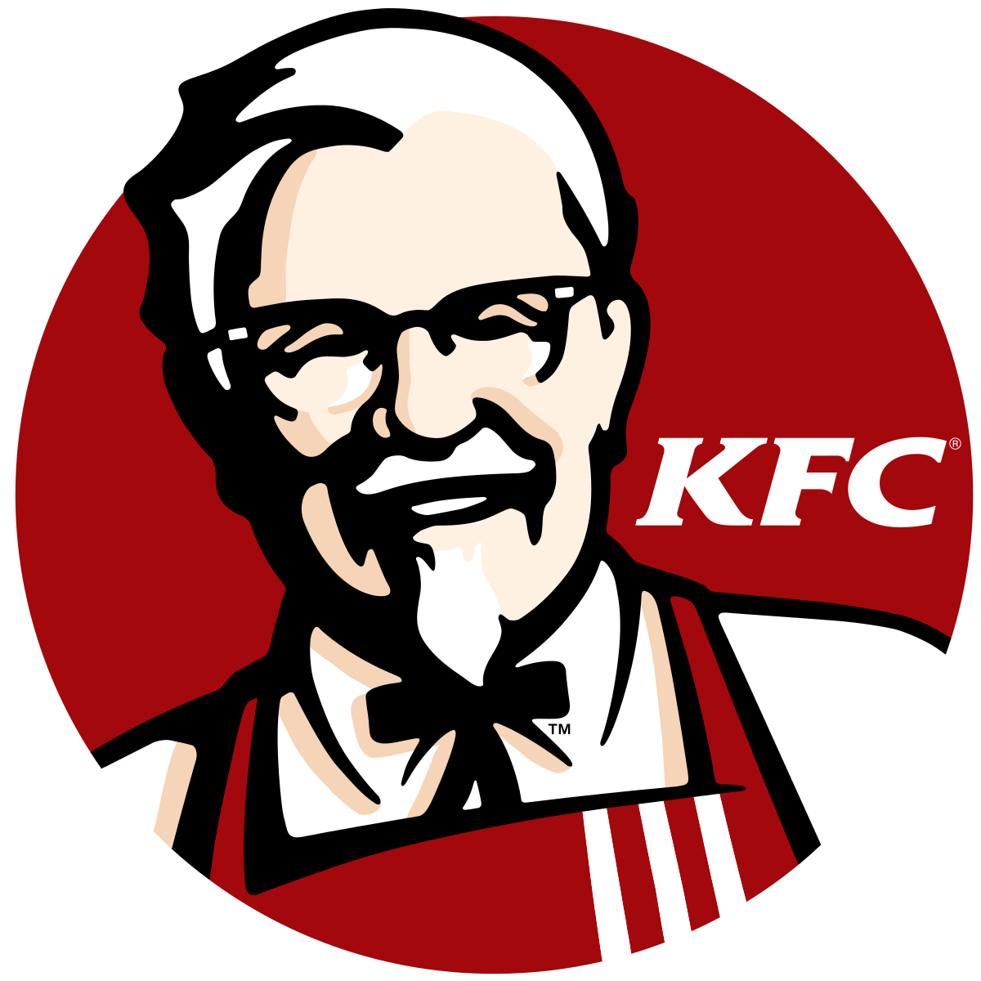
Competitor Analysis
BRAND | PHYSICAL STORES | ONLINE DELIVERY | VARIOUS FLAVOURS | BRAND IDENTITY | PRICING | MENU VARIETY
Notes:
Here is a list of well-known fried chicken businesses we chose for competitor analysis to highlight their strengths and weaknesses.
All the brands have boneless fried chicken options in their menu, which More Batter focuses on.
Wingstop
Wingstop was founded in 1994 in Texas, USA. Wingstop entered the Singaporean market in 2013 and has been well-received by Singaporean customers, who appreciate the chain's high-quality wings and unique flavours.
Market and Industry
Wingstop specialises in wings and offers a wide range of flavours, including Texas Buffalo, Teriyaki, Mango Habanero, Hickory Smoked BBQ, Inferno, Lemon Pepper, Kecap Manis, Garlic Parmesan, and Louisiana Rub.
Branding and Marketing
Wingstop has a distinctive brand identity centered around its wings and flavours. It also has a strong social media presence, using platforms like Twitter and Instagram to engage with customers and promote its products. In addition, Wingstop has partnered with sports teams and events to reach a wider audience.
Menu and Product Innovation
Wingstop’s menu is focused on wings, but it also offers other items like fries, sides, and dips. The company has a reputation for its unique flavours, which are frequently updated and expanded. In recent years, Wingstop has also experimented with new products like boneless wings and chicken sandwiches. A popular boneless chicken menu option that Wingstop provides is the 6 or 8 piece Boneless Wing Combo, priced on the steeper side at S$12.25 and S$14.25 respectively.
Physical Stores and Online Delivery
There are 11 Wingstop restaurants in Singapore. Wingstop also offers online delivery and partners with food delivery platforms such as GrabFood, Deliveroo, and FoodPanda.
4Fingers
4Fingers is a Singaporean fast-food restaurant chain that specialises in crispy fried chicken, offering a range of flavours and sides. It was founded in 2016 and has since expanded to several locations across Singapore, as well as in Malaysia, Thailand, and Indonesia. The company offers a variety of wings, from classic bone-in wings to boneless wings, and offers a wide range of unique and distinctive flavours, such as salted egg yolk, soy garlic, and hot sauce. 4Fingers' wings are also known for being crispy and juicy, and the company prides itself in using hormone-free and antibiotic-free chicken.
Market and Industry
4Fingers specialises in wings and offering a unique mix of Asian and Western flavours.
Branding and Marketing
4Fingers has a distinctive brand identity centered around its slogan "crispy, juicy, and flavourful." The company has also cultivated a strong social media presence, using platforms like Facebook and Instagram to engage with customers and promote its products. 4Fingers has also expanded its reach through partnerships with food delivery services and catering.
Menu and Product Innovation
4Fingers' menu is focused on chicken wings, with a variety of flavours to choose from, including salted egg yolk, soy garlic, and hot sauce. In addition, the company has also added in other items like fries, burgers, and drinks to its menu to provide a more complete fast-food experience. 4Fingers is also known for its sustainable approach to sourcing for ingredients, using hormone-free and antibiotic-free chicken. A popular boneless chicken menu option that 4Fingers provides is its 6, 12, and 18 piece Boneless chicken bites, priced from S$10.30, S$18.70, and S$25.40 onwards respectively.
Physical Stores and Online Delivery
There are 21 4Fingers restaurants in Singapore. 4Fingers also offers online delivery and partners with food delivery platforms such as GrabFood, Deliveroo, and FoodPanda.
KFC
KFC, also known as Kentucky Fried Chicken, is a fast-food chain specialising in fried chicken. Founded in 1930, KFC first entered the Singaporean market in 1977. KFC Singapore has established a reputation for its high-quality fried chicken, innovative flavour offerings, and convenience, which have helped it become a popular fast-food chain in Singapore.
Market and Industry
KFC focuses on Western bone-in fried chicken, and has a global presence with over 22,000 locations in more than 135 countries.
Branding and Marketing
KFC has a strong brand identity centered around its Colonel Sanders mascot, its "finger-lickin' good" slogan, and its iconic red and white logo. The company has also utilised advertising and social media to promote its products and engage with customers.
Menu and Product Innovation
KFC's menu is focused on fried chicken, with a variety of different flavours and meal options. In addition, the company has added in items like sandwiches, salads, and sides to its menu to provide a more complete fast-food experience. KFC is also known for its innovation, such as the introduction of the Double Down sandwich and its plant-based chicken options. A popular boneless chicken menu option that KFC provides is the Zinger Burger, priced from S$6.90 onwards.
Physical Stores and Online Delivery
There are 84 KFC restaurants in Singapore. 4Fingers also offers online delivery and partners with food delivery platforms such as GrabFood, Deliveroo, and FoodPanda.
Coming back to our brand.
More Batter
More Batter was first launched in September 2022. It is an online food brand that mainly focuses on boneless fried chicken delivered through third-party delivery platforms.
Market and Industry
More Batter focuses on boneless fried chicken. The brand aims to take customers on a journey to different places in the world (“Customer Journeying”) – one fried chicken at a time, by theming each season to a particular locale’s cuisine. For its first season, More Batter has adopted a South Korean theming.
Branding and Marketing
More Batter’s boneless fried chicken is served in a slim, compact box for ease of sharing, transporting and photo taking. More Batter also came up with slogans for its first season: Together with authentic Korean sauces, it definitely makes you want to say “”완전대박! 순살치킨” (Wanjeon Daebak! – which means ‘really awesome boneless fried chicken’ in Korean).
Menu and Product Innovation
More Batter focuses on a boneless fried chicken menu with a variety of flavours, including Seaweed, Honey Garlic, Cheesy Gochujang, White Slaw, Ginger Soy, and Gochujang. Popular boneless chicken menu options that More Batter provides are the Wanjeon Daebak Silks set and Daebak Sam set.
Physical Stores and Online Delivery
There are no physical restaurants in Singapore. More Batter offers online delivery and partners with food delivery platforms such as GrabFood, Deliveroo, and FoodPanda.
Comparison
Physical Stores
More Batter does not have a physical store. Wingstop and 4Fingers offer a casual dining ambiance with a focus on quick service, while KFC more closely resembles a traditional fast-food restaurant.
Online Delivery
All the brands provide online delivery and partner with third-party delivery platforms.
Various Flavours
All the brands provide uniqueness in flavours and offer creativity through their wide range of menu options.
Long Standing
More Batter is relatively new compared to other brands that have been around for more than 10 years.
Pricing
Four Fingers and KFC are more affordable than Wingstop and More Batter, but the price depends on the specific items ordered. Wingstop is known for its premium quality chicken and unique flavour offerings, while More Batter is known for its boneless chicken, so it may be more expensive than other brands.
Menu Variety
Wingstop and Four fingers provide overall larger menu options for customers to choose from compared to More batter and KFC, with More Batter having less menu options.
By comparison, More Batter is lacking in brand identity, pricing, and menu variety.
Wingstop Restaurants, Inc. (2023) https://www.wingstop.com.sg/
4Fingers Pte. Ltd. (2023) https://www.4fingers.com.sg/
KFC Singapore. (2021) https://www.kfc.com.sg/
More Batter. (2023) https://morebatter.com.sg/

Slide 12
Drawing Inspiration
UNIQUE FLAVOURS
Present in both chicken and sides
PREDICTABILITY
To keep customers coming back
VALUE FOR MONEY
Convince buyers that More Batter is worth their money
EVOKE CURIOSITY
To turn potential buyers into first-time buyers
Notes:
As such, More Batter can draw inspiration from all 3 competitors.
Wingstop, despite only being established in Singapore in 2013, quickly became a “fan favourite” chicken outlet. It is therefore a relatively new brand in Singapore with exciting flavour combinations and flavourful Western sides.
On the other hand, 4Fingers is a Singaporean brand that took inspiration from Korea. It combines both Korean flavours and Western flavours to create a colourful menu that comprises rice boxes, rice burgers, and kimchi coleslaw. They therefore do an excellent job of fusing the familiar and unfamiliar.
When we talk about fried chicken, we cannot omit KFC, also known as the “father” of fried chicken. It has consistent and predictable flavours – you basically know exactly what you will be getting from them regardless of where you go, what time it is, and how old you are! It also has an iconic mascot in the form of Colonel Sanders, which is widely known by everyone around the world.
All three are considered relatively affordable chicken brands. Not the cheapest, but economical nonetheless.
From these 3 competitors, we can draw the following inspirations:
Firstly, unique flavours. In order for customers to continue returning back, unique flavours must be constantly introduced for the menu to stay fresh.
Secondly, predictability. While we do need to change things up once in a while, certain items in the menu should still be retained so that customers are able to come back to their favourite flavours, hence retaining that comforting sense of familiarity.
Thirdly, value for money. Customers need to be convinced that what they are getting from us is worth their money. More Batter must ensure that a certain standard is maintained in the production of fried chicken such that the price tag justifies for the quality.
And lastly, evoking curiosity. Unlike household brands like KFC, More Batter is still relatively unknown. In order to attract customers to give it a try, we need to evoke curiosity to pique their interest in the brand.

Slide 13
Value Proposition
Providing an “all-in-one” sensory gastronomical experience worth every dollar, where customers can learn and play beyond enjoying fried chicken.
Gain Creators
Pain Relievers
Providing value set meals, menu discounts, and free add-ons
Having a new seasonal theme for the brand
Creation of mascot for marketing campaign
Organising a physical pop-up exhibition for customers to learn more about More Batter
Providing cheaper meal tiers with options to customise the meal
Having a marketing campaign that utilises social media to spread awareness
Having a variety of unique food choices for the brand
Having physical distribution points across the island
Notes:
Our value proposition describes how our fried chicken products and services can be made attractive to customers.
At More Batter, we aim to provide an “all-in-one” sensory gastronomical experience worth every dollar, where customers will get to learn and play beyond enjoying fried chicken.
To achieve this, we have adopted some gain creators and pain relievers.
Gain creators show how our product and service creates customer gains and how it offers added value to customers.
Pain relievers show a description of exactly how our product and service alleviates customer pains.
Based on the gains and pains we identified earlier, we have come up with gain creators and pain relievers that directly address them. The solutions discussed later on are crafted based on the gain creators and pain relievers mentioned.
Gain Creators
Providing value set meals, menu discounts, and free add-ons
Addresses the gain of incentivising customers to try More Batter fried chicken.
Solution: As mentioned above.
Having a new seasonal theme for the brand
Addresses the gain of customers being excited to try a new trend/fried chicken flavour.
Solution: The new seasonal theme will take the More Batter brand to Thailand, with Thai-styled flavouring and sides to pair with it. This encourages customers to try our fried chicken.
Creation of a mascot for marketing campaign
Addresses the gain of having a recognisable brand icon that customers can identify with.
Solution: As mentioned above.
Organising a physical pop-up exhibition
Addresses the gain of having a unique brand experience, one that goes beyond the food and is interactive and informative.
Solution: The physical exhibition will allow customers to play fun games, win prizes (including discount vouchers and free add-ons), and also learn more about the brand through the process. Gallery panels are displayed for customers to learn more about the different Thai regions and origins of the cuisines that inspired the fried chicken flavours offered on the menu.
Pain Relievers
Providing cheaper meal options, while also having the option to customise the meal
Addresses the problem of customers finding the fried chicken to be too expensive.
Solution: Launching a “Build Your Own Box of 1” set, and a mini taster set. Customers can customise their meals by selecting the flavour of chicken and sides preferred.
Having a marketing campaign that utilises social media to spread awareness
Addresses the problem of customers being hesitant to try the fried chicken as the brand is relatively unknown.
Solution: Hiring Singaporean and Thai influencers that are popular in Singapore to help spread the word of the brand.
Solution: Collaboration with TheSmartLocal and Eatbook - brand promotion in exchange for free food and content.
Having a variety of unique food choices for the brand
Addresses the problem of lack of differentiation and customers not being convinced to return after their initial try.
Solution: Creating 3 unique flavour sets for customers to try.
Having physical distribution points across the island
Addresses the problem of customers not seeing the value of an e-commerce brand.
Solution: As mentioned in the slides on gains and pains, there is a lack of human touch that customers would experience in a physical store. Physical distribution points will be set up across the island so that customers can visit them to collect their fried chicken.

Slide 14
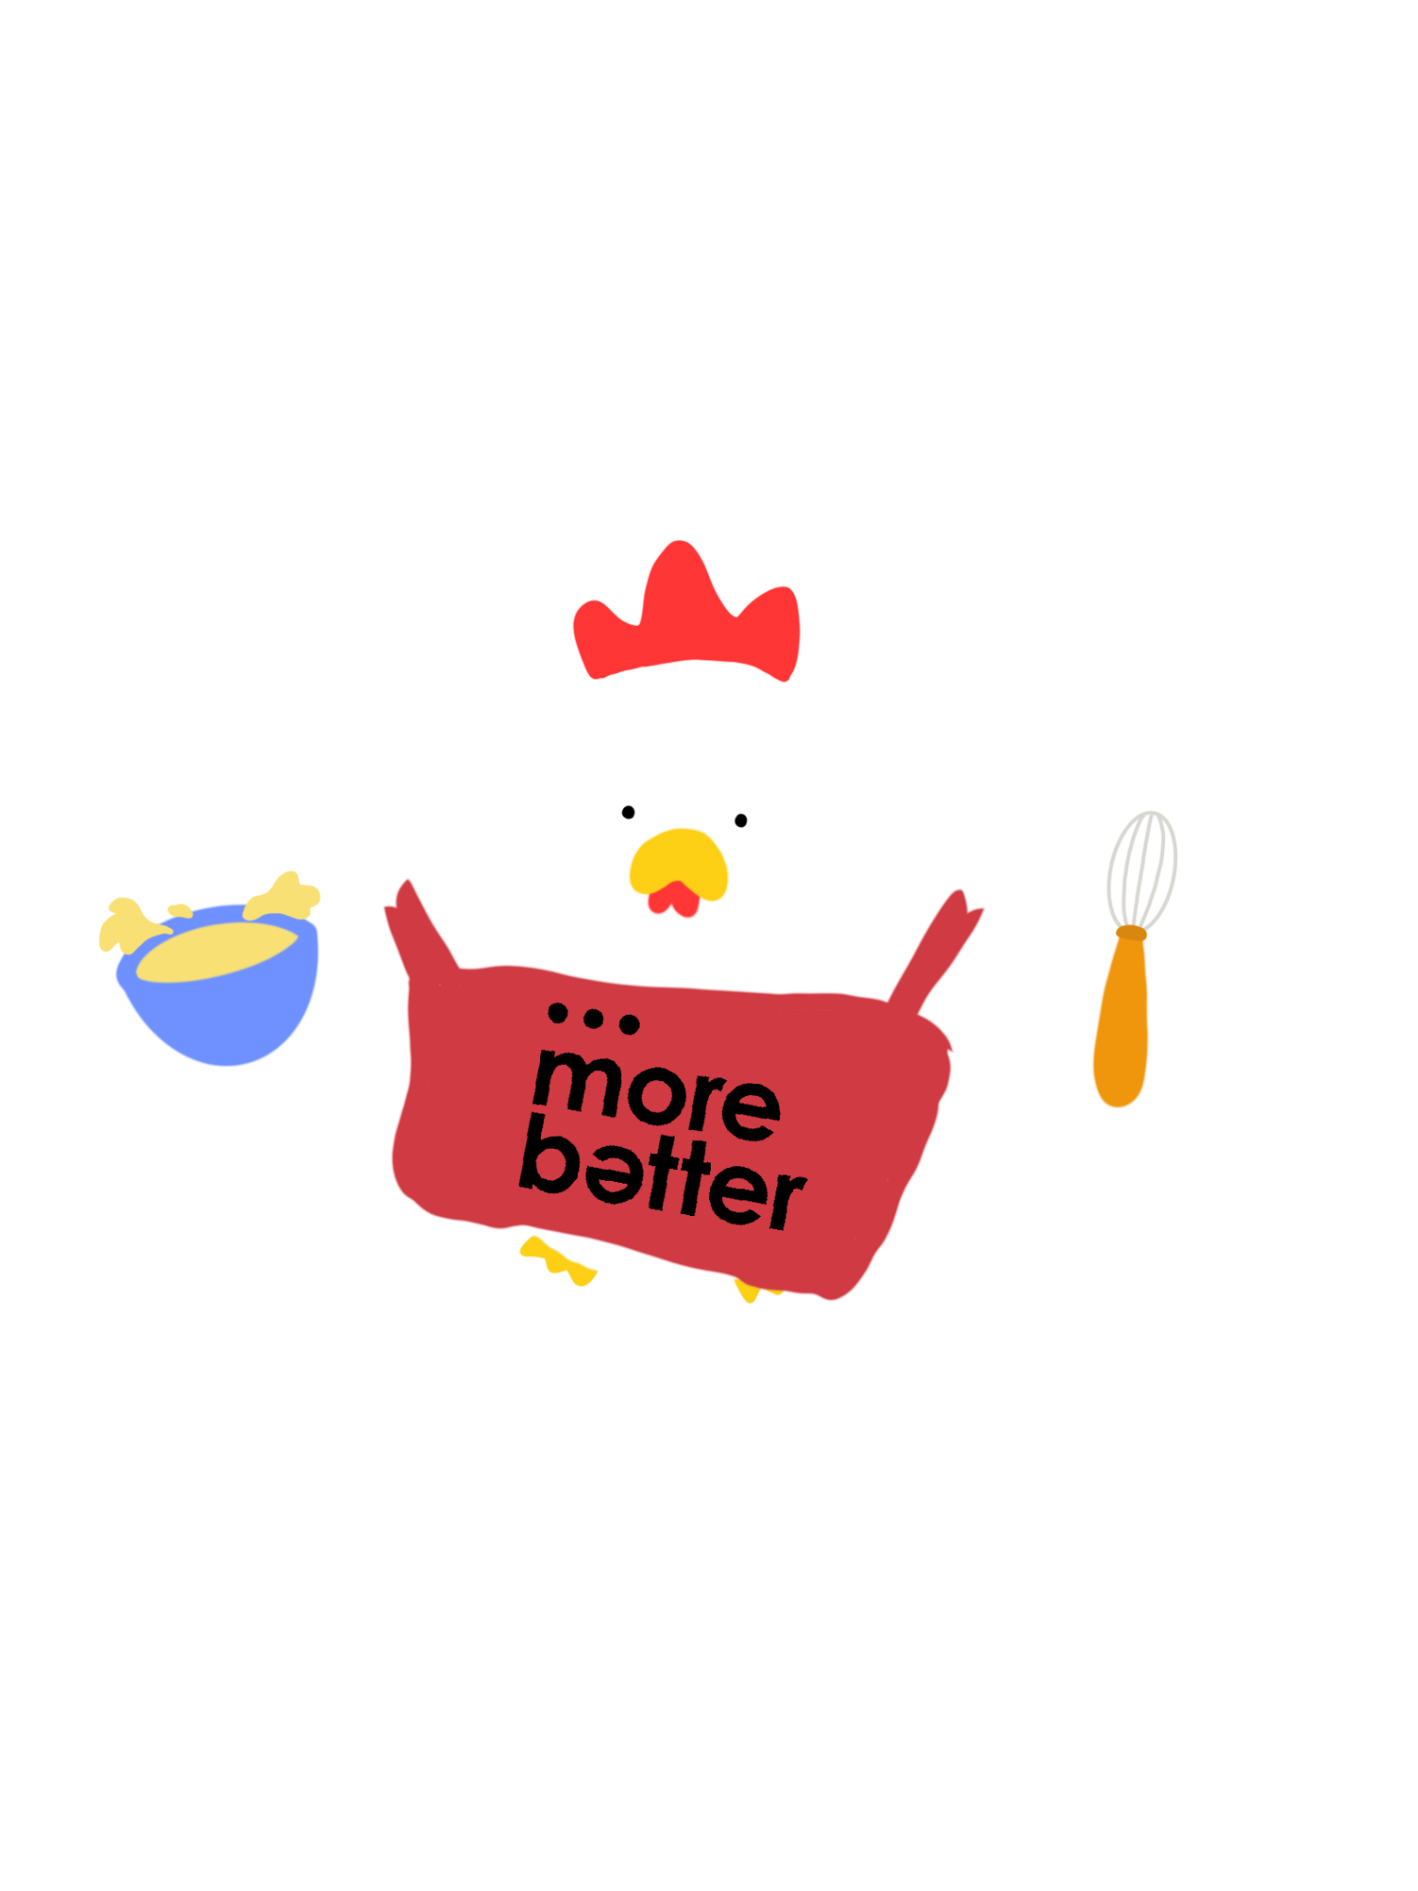

Maurice: The More Batter Chicken
Adorable cartoon design
Generate fondness and sense of attachment
Bowl and whisk
Represent the creation of BATTER
Notes:
Firstly, we will be launching a mascot, affectionately named “Maurice” (a rhyme on More Batter), to establish a unique brand identity that customers can associate More Batter to (Gains). The catchphrase “Maurice, the More Batter Chicken” will be used throughout our promotional events as a catchphrase that is easy to remember for customers.
Maurice, the More Batter Chicken dons a red apron with the More Batter logo emblazoned, and poses with a whisk and a bowl of batter in hand to represent the creation of the crispy BATTER – which is very on brand! The mascot is designed to be cute and adorable for customers to develop fondness and form an attachment to the character.

Slide 15
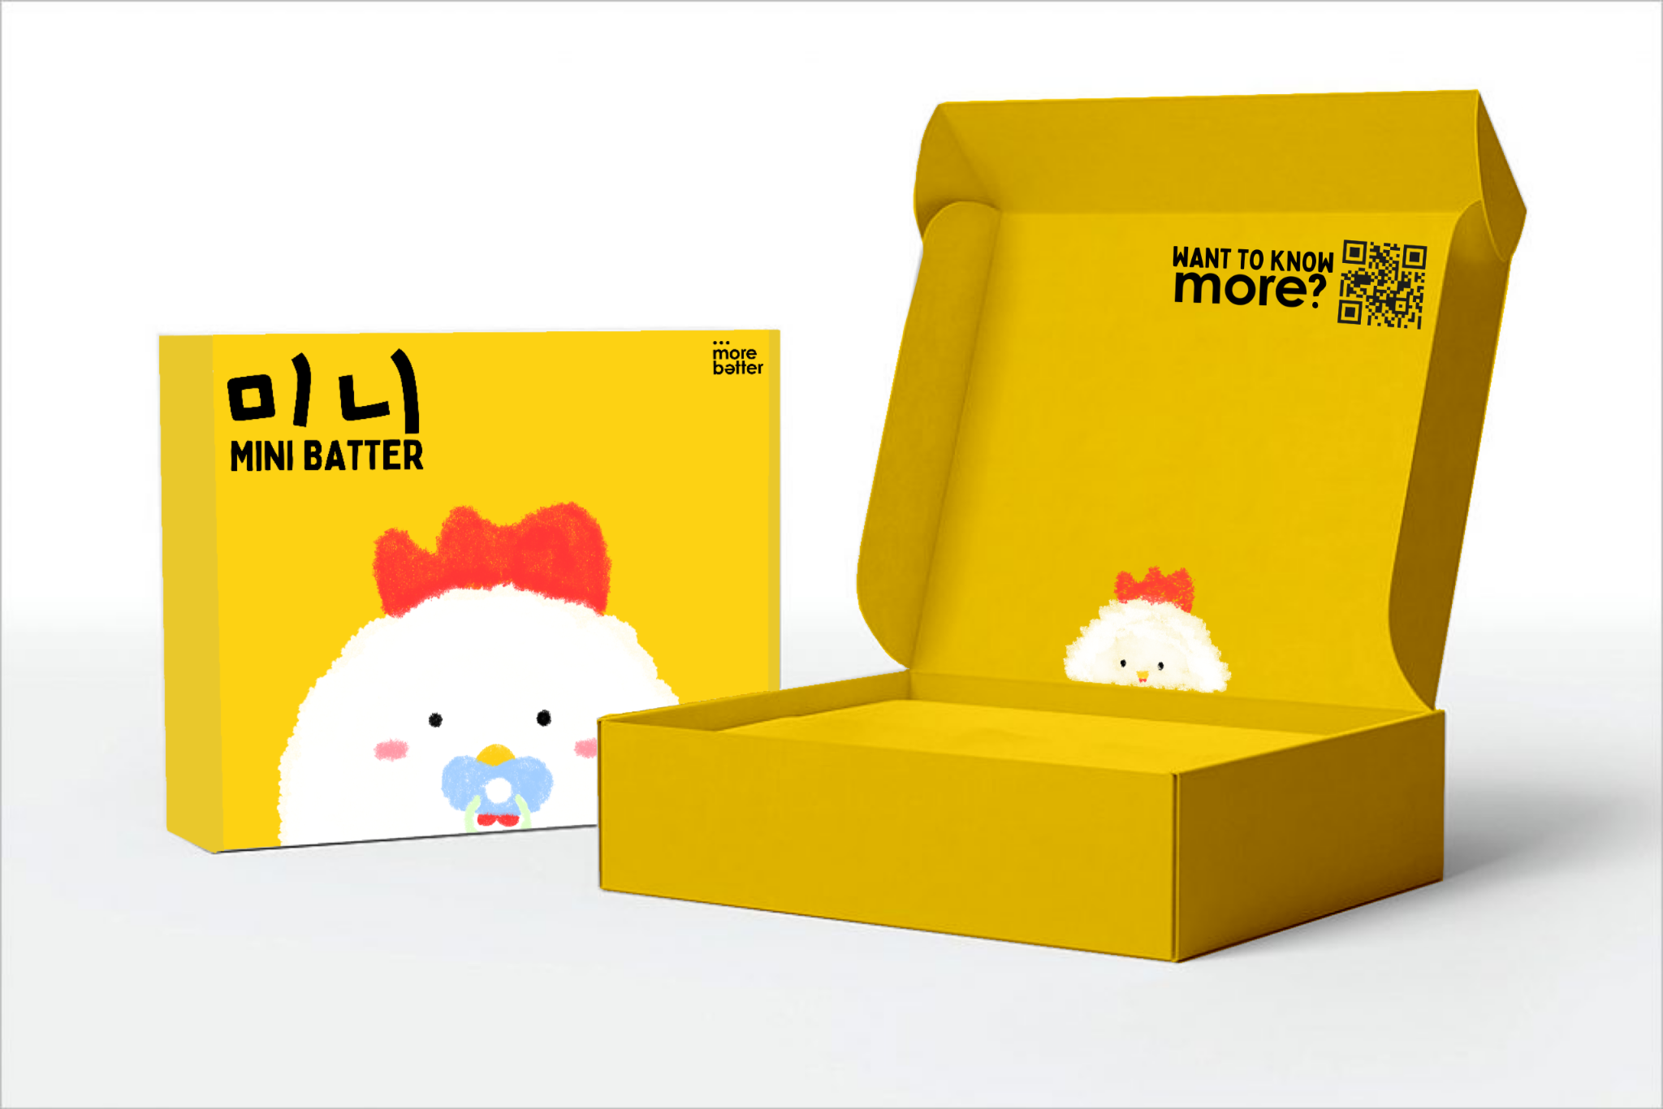

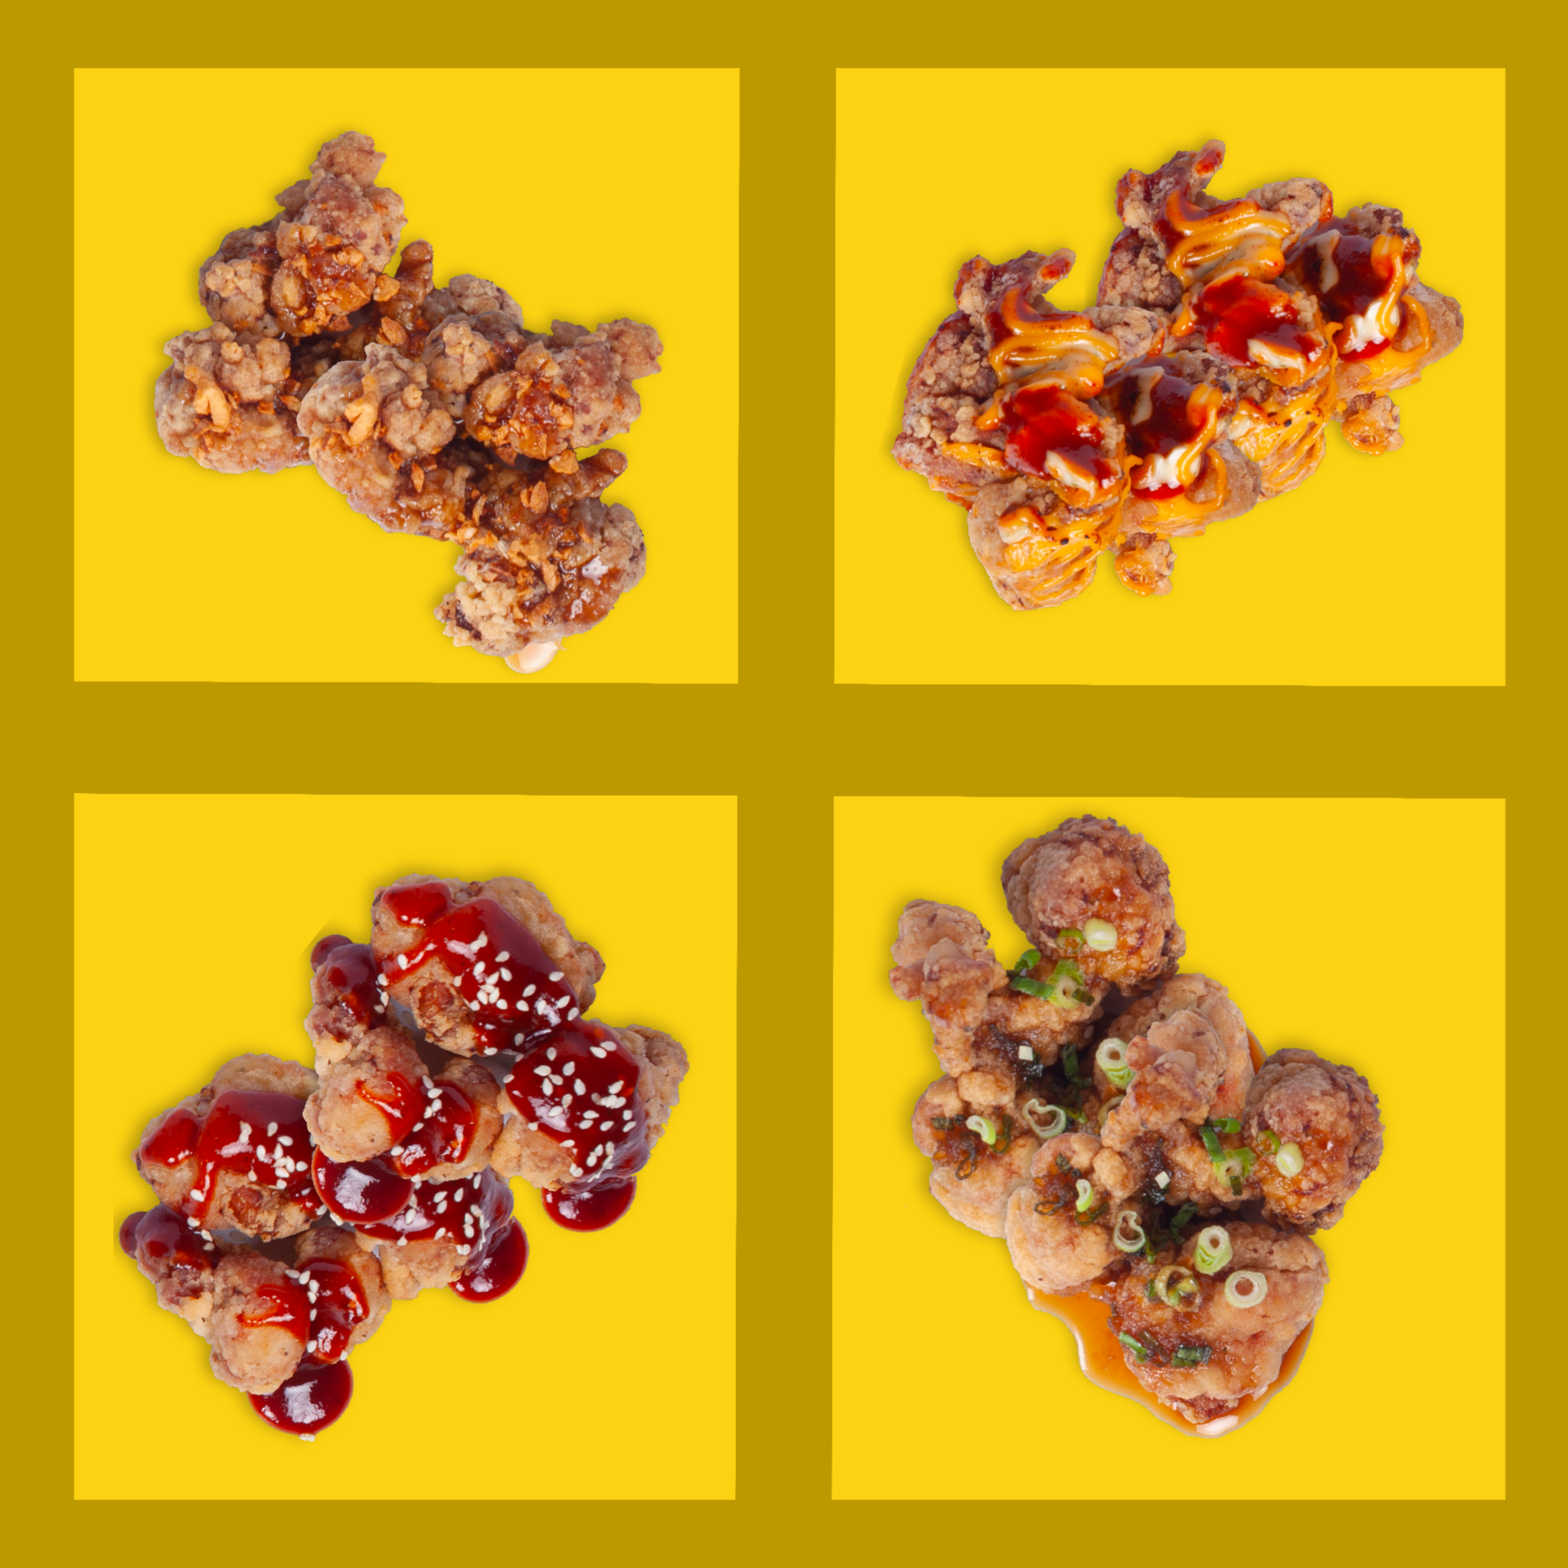
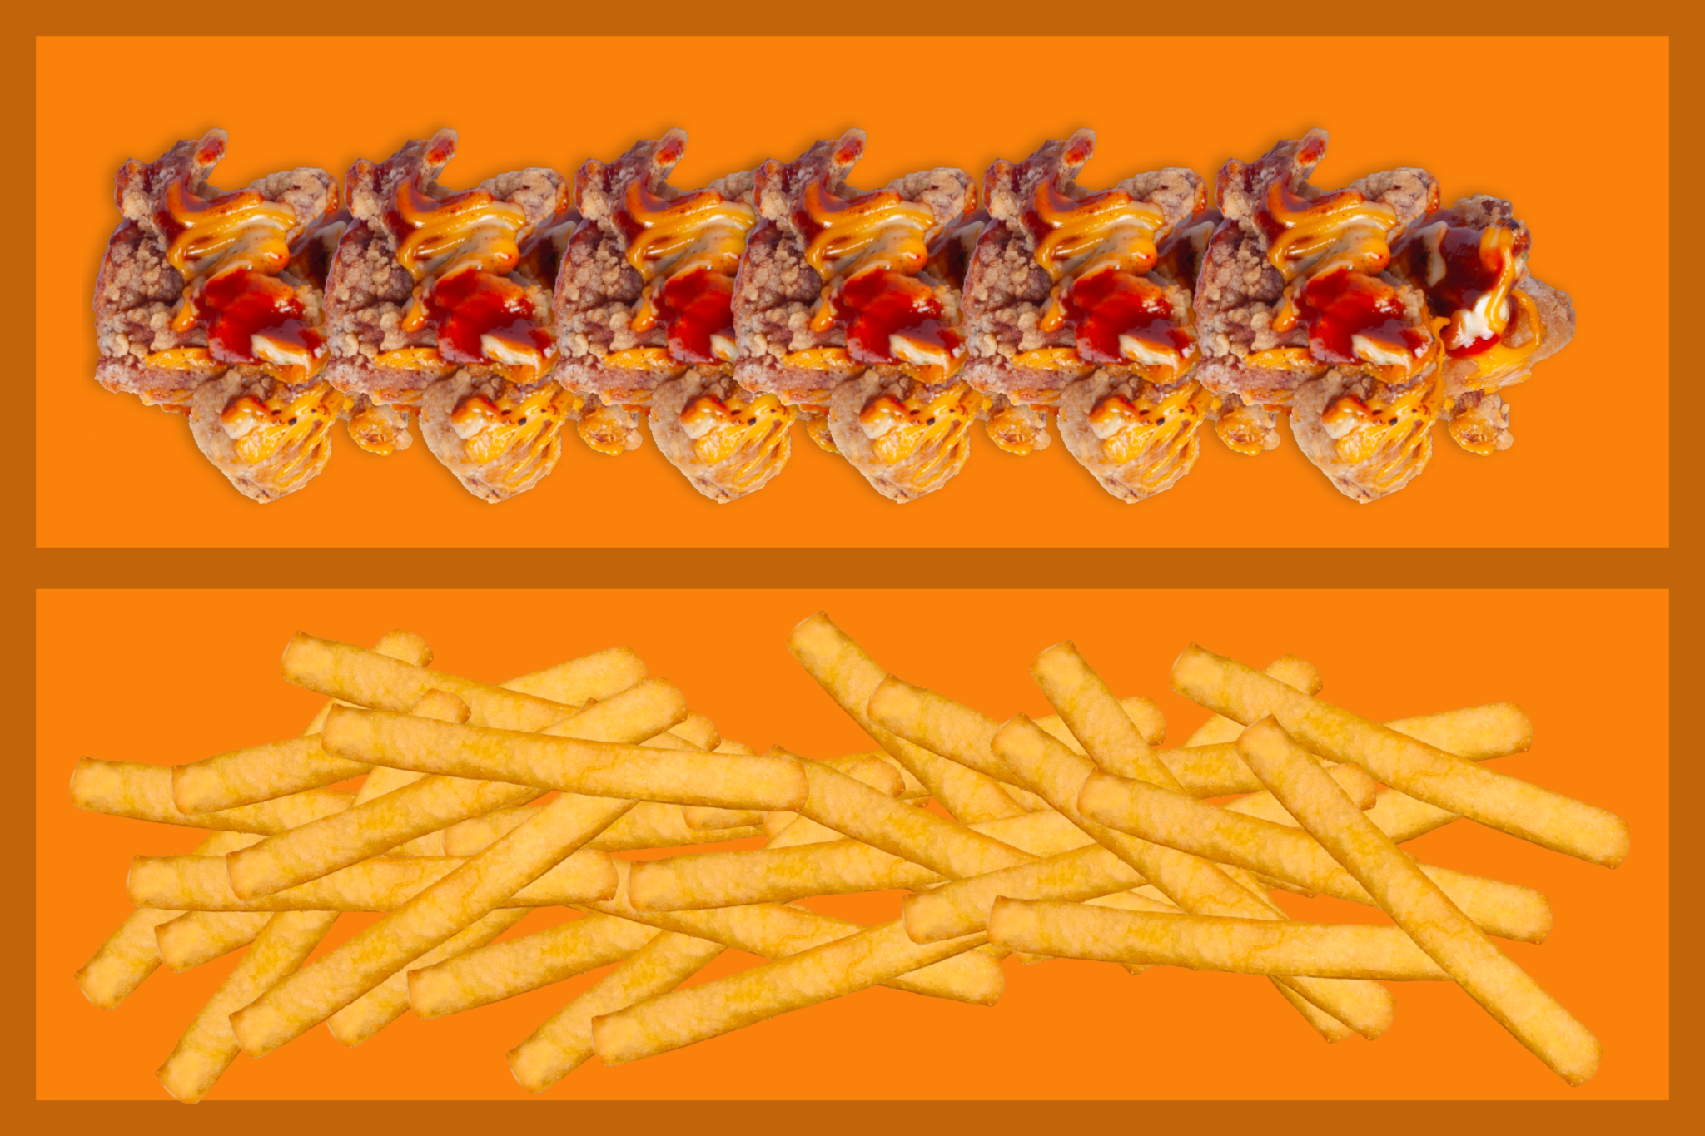
New Sets for Greater Flexibility of Choice
BYOB of 1
8 pieces of chicken
1 flavour
1 side
From S$10
Mini Taster Box
8 pieces of chicken
4 different flavours
S$8
Notes:
Currently, More Batter offers two fried chicken sets, as well as two customisable sets for the Korean season.
Fried Chicken Sets
Daebak Sam Set (S$22.70)
Suitable for 1 to 3 pax
Includes White Slaw fried chicken, Honey Garlic fried chicken, and seaweed fries
Wanjeon Daebak Siks Set (S$44.40)
Suitable for 3 to 6 pax
Includes White Slaw fried chicken, Honey Garlic fried chicken, Ginger Soy fried chicken, Gochujang fried chicken, original fries, and seaweed fries
Customisable Sets
Build Your Own Box of 3 Set (From S$19.70)
Suitable for 1 to 3 pax
2 rows x fried chicken
1 rows x fries
Build Your Own Box of 6 Set (From S$39.40)
Suitable for 3 to 6 pax
4 rows x fried chicken
2 rows x fries
However, many customers have reflected that the price points of More Batter’s fried chicken are too high, as seen from the responses in our survey. (Refer to Survey Results in Annex - Most customers are only willing to pay lower price ranges for More Batter’s products.) This is one of the factors that prevents them from trying or revisiting the brand. To address this issue, our team will be proposing two new fried chicken sets with lower price points for greater flexibility of choice.
Build Your Own Box of 1 (From S$10) - For those who are strapped for cash but still wish to treat themselves
Suitable for 1 pax
1 row x fried chicken
1 row x side dish
We innovated on More Batter’s current packaging to include Maurice, the More Batter Chicken. The colour of the box was changed to orange in order to make the packaging extremely striking and memorable. Their original Korean catchphrase was retained.
Mini Taster Box (S$8) - For new customers to try a greater variety of fried chicken flavours
Suitable for 1 pax
4 compartments
2 pieces of fried chicken per compartment (of the customer’s flavour of choice)
The design of the mini taster box depicts baby Maurice, the More Batter Chicken to show exactly what this set is – mini! When consumers open the box up, another little Maurice, the More Batter Chicken will be waiting to greet them.
Through the implementation of these adorable designs depicting Maurice, the More Batter Chicken, we hope to entice more customers into purchasing these boxes.

Slide 16
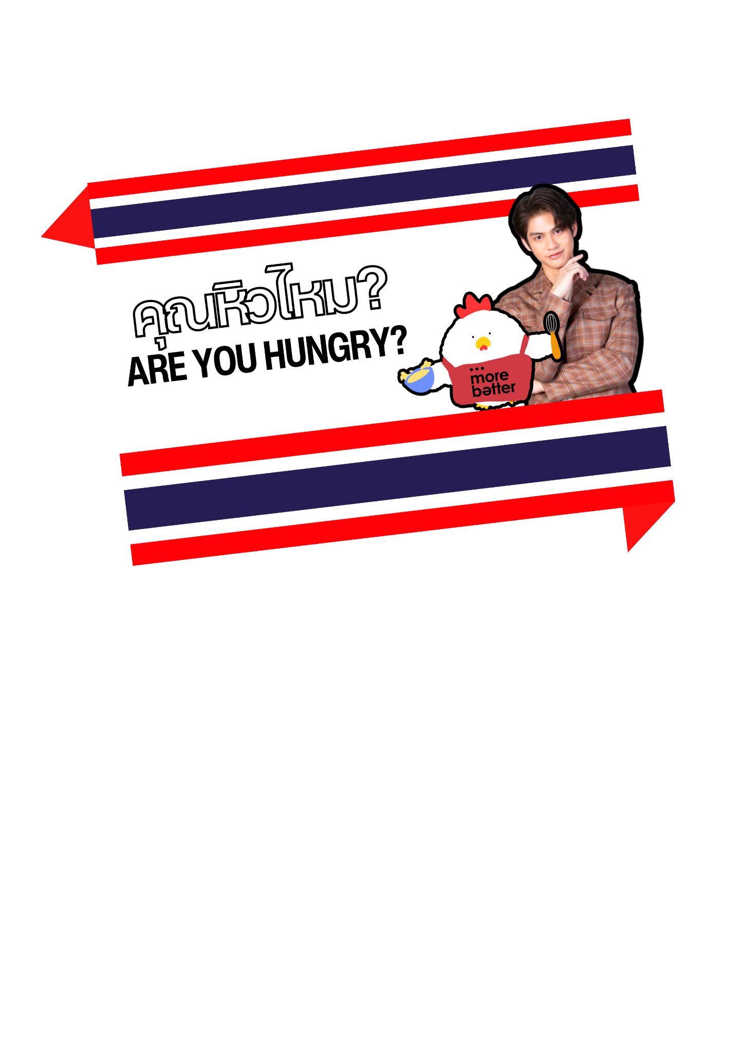
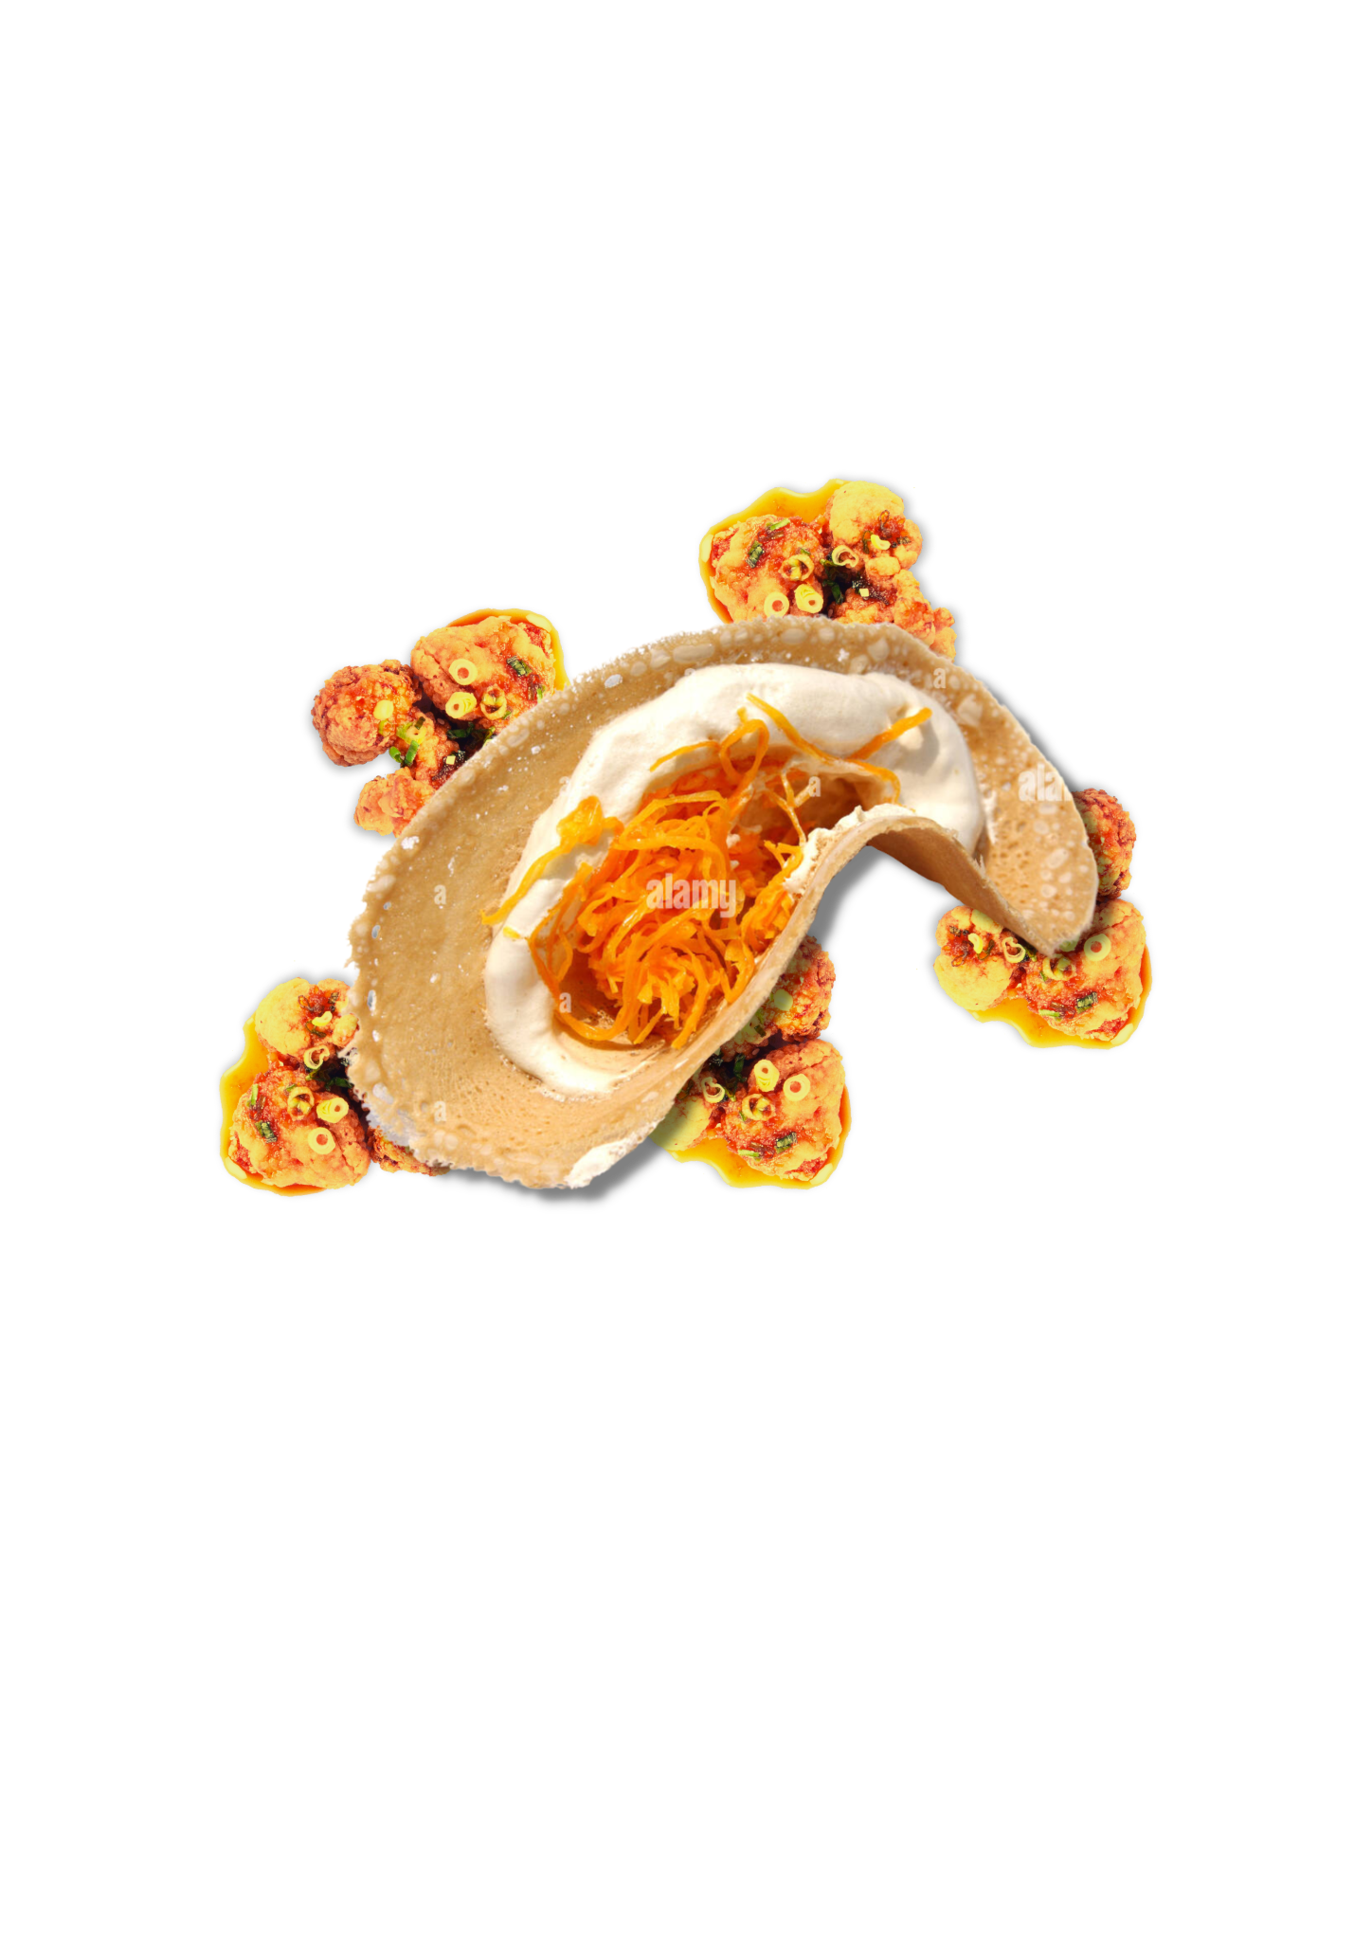
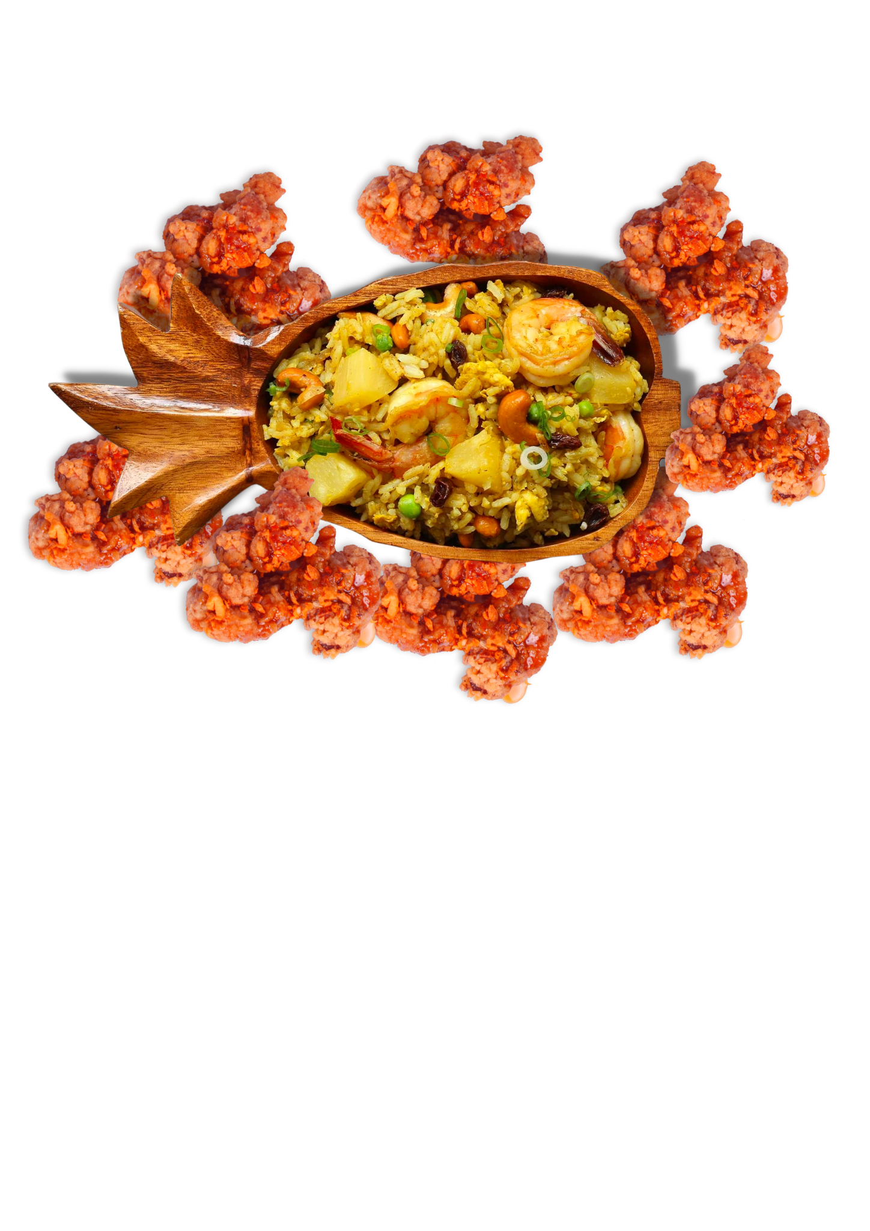
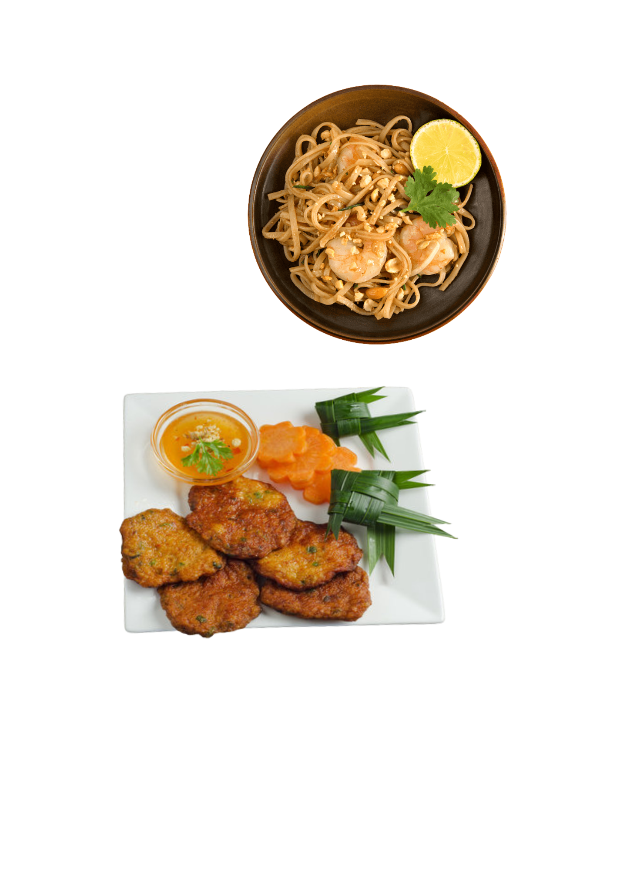
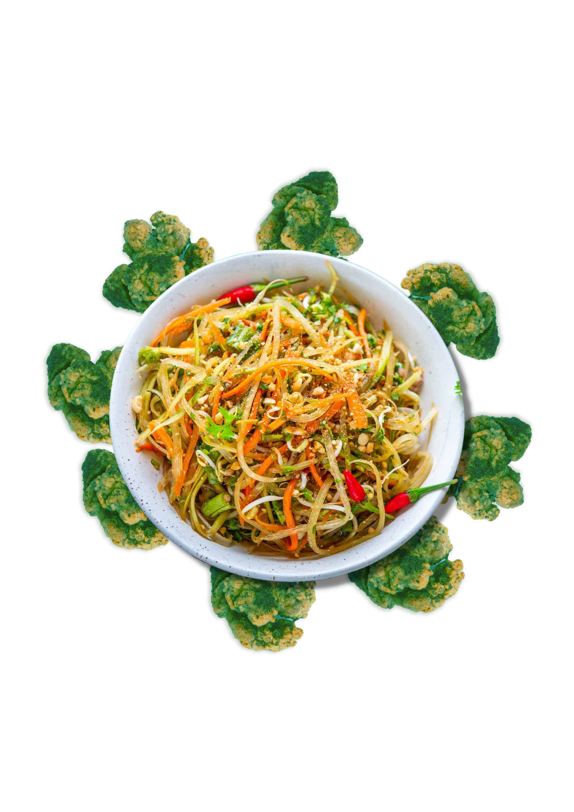
Next Destination: Thailand
Mango Glazed Chicken with Thai Crepes
Spicy Tom Yum Chicken with Pineapple Fried Rice
LIMITED
EDITION!
Creamy Green Curry Chicken with Papaya Salad
Savoury Thai Fish Cakes with Pad Thai
Notes:
The country that we have chosen for More Batter’s next season is Thailand. The main reason for this is due to Singaporeans’ unwavering love for Thai culture, which are demonstrated in the following examples:
Chatuchak Night Market Singapore
Chatuchak Night Market is the largest and arguably the most popular weekend market in Bangkok, Thailand. The night market has recently touched base again in Singapore at The Grandstand, and will be open from 7 February to 2 April 2023. Hosting a total of 180 vendors selling a variety of Thai delicacies such as Boat Noodles, Pork Skewers, and Coconut Shakes (Khoo, 2023), the event drew hoards of Singaporeans who had to wait 1-3 hours to queue for their food (Teo, 2023).
Thai Food Establishments in Singapore
Numerous restaurants and fast food chains such as Nakhon Kitchen, Sanook Kitchen, and Saap Saap Thai have found relative success offering Thai cuisines to Singaporeans. Mookata has also been gaining prominence in Singapore, with many stalls islandwide such as Siam Square Mookata providing an avenue for Singaporeans to dine in and enjoy the steamboat. The high supply of Thai food establishments showcases that there is a high market demand for Thai cuisines that cater to local tastebuds.
Thai Drama and Pop Wave
There has been a rise in popularity of Thai dramas and music in the entertainment scene. Dramas such as 2gether and F4 Thailand: Boys over Flowers have garnered an avid fan base for actors such as Bright Vachirawit and Win Metawin. Thai musicians such as Tilly Birds and Milli are up-and-coming as well (Tan, 2022). These are potential influencers whom we can tap into for our promotional activities for the new season.
Going with the Thai theming, we will be proposing the following recommended flavours in the following sets. These sets are also customisable under the Build Your Own Box of 1, 3, or 6 Sets, and the Mini Taster Box.
Set 1: Creamy Green Curry Chicken with Papaya Salad - for those who enjoy rich flavours (S$12)
Set 2: Spicy Tom Yum Chicken with Pineapple Fried Rice - for those who love a spicy kick (S$12)
Set 3: Tangy Mango Glazed Chicken with Thai Crepes - for those with a sweet tooth (S$12)
When buying a set of 3 or 6, customers can look forward to our limited edition Thai themed packaging! The top and bottom borders of the box depict the colours of the Thai flag, and in the centre – fan-favourite Thai actor and potential brand ambassador, Bright Vachirawit, alongside Maurice, the More Batter Chicken.
These fried chicken sets would meet the desires of customers looking for tenderness, crispiness and juiciness in fried chicken, as seen from the responses in our survey (Refer to Customer Profiles and Survey Results in Appendix - The top 3 things that customers look for in fried chicken are tenderness, crispiness, and juiciness).
To celebrate the new season launch, we will also be releasing a limited edition set to attract more customers.
Limited Edition Set: Savoury Thai Fish Cakes with Pad Thai - for those who prefer an alternative source of protein (S$10)
This limited edition set would also allow us to pilot test the popularity of fish as an alternative food offering at More Batter.
Khoo, H. Chatuchak Night Market Singapore returns with 180 stalls on Feb 7. The Straits Times. https://www.straitstimes.com/life/food/chatuchak-night-market-singapore-returns-with-180-stalls-on-feb-7
Teo, M. 'Extremely ridiculous': Man warns of 3-hour waiting times at Chatuchak Singapore as event draws massive crowds. AsiaOne. https://www.asiaone.com/singapore/extremely-ridiculous-man-warns-3-hour-waiting-times-chatuchak-singapore-event-draws
Tan, A. Thai pop is on the rise—here are 5 artists to know of. Vogue Singapore. https://vogue.sg/thai-pop-artists-to-know/

Slide 17
Key Distribution Points
Tertiary Students
Clementi, Boon Lay, City Hall
Young Working Adults
CBD, Queenstown, Geylang, Bukit Merah, Tampines
Survey Results
Jurong Point, Tampines Mall, Jewel, Nex, Plaza Singapura
Distribution Points
Jurong Point
Tampines Mall
Plaza Singapura
Jewel Changi Airport
Causeway Point
Notes:
We have selected a total of 5 distribution points. These locations were carefully selected to cover different regions of Singapore. The rationale for each chosen location are stated below.
Jurong Point (West - Boon Lay MRT Station)
Near to NTU (Boon Lay)
Near to NUS (Clementi)
Near to Queenstown and Bukit Merah (where most Young Working Adults work)
Most popular among survey respondents (Refer to Survey Results in Annex)
Tampines Mall (East - Tampines MRT Station)
Near to SUTD (Upper Changi)
Near to Tampines (where most Young Working Adults work)
Second most popular among survey respondents (Refer to Survey Results in Annex)
Jewel Changi Airport (East - Changi Airport MRT Station)
Third most popular among survey respondents, tied with Nex and Plaza Singapura (Refer to Survey Results in Annex)
Possibility of attracting more customers due to large volume of tourists and Singaporeans alike visiting the mall
Potential for the brand to gain international attention, paving the way for global expansion in the future
Plaza Singapura (Central - Dhoby Ghaut MRT Station)
Near to SMU (City Hall)
Near to CBD (where most Young Working Adults work)
Third most popular among survey respondents, tied with Nex and Jewel Changi Airport
Possibility of attracting more customers as the mall is located along Orchard Road, a high-traffic area in Singapore
Causeway Point (North - Woodlands MRT Station)
Having selected shopping malls in the west, east, and central, Causeway Point would be an ideal fifth location situated in the North to ensure a good spread of distribution points
Possibility of attracting more customers as Causeway Point is frequented by Malaysians travelling across the nearby Woodlands Causeway
Potential for the brand to gain international attention, paving the way for global expansion in the future

Slide 18
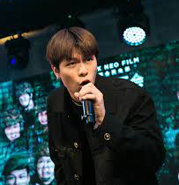
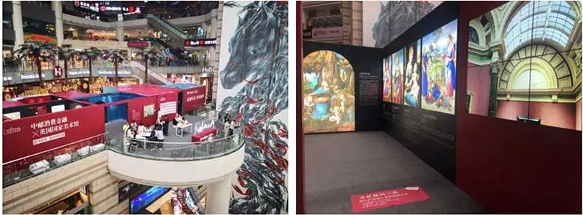
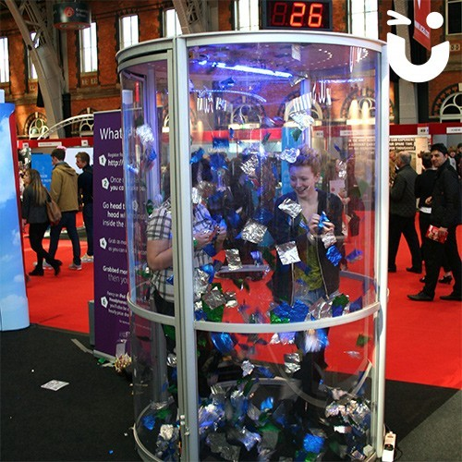
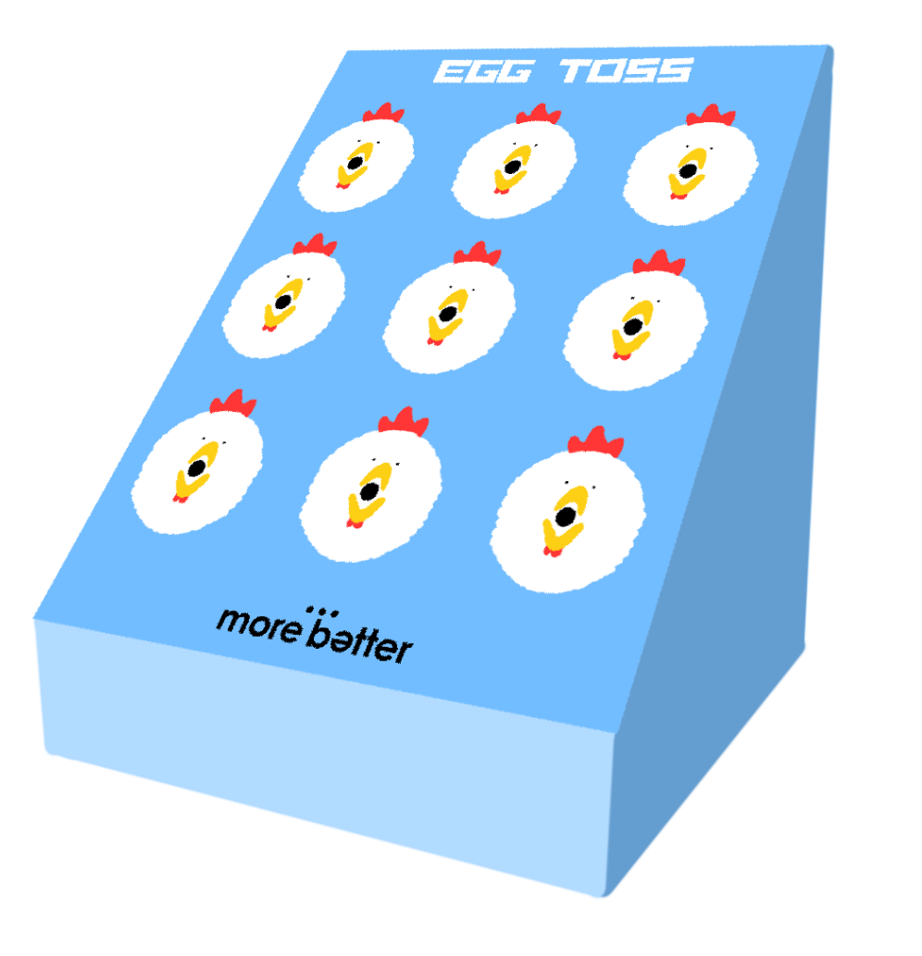
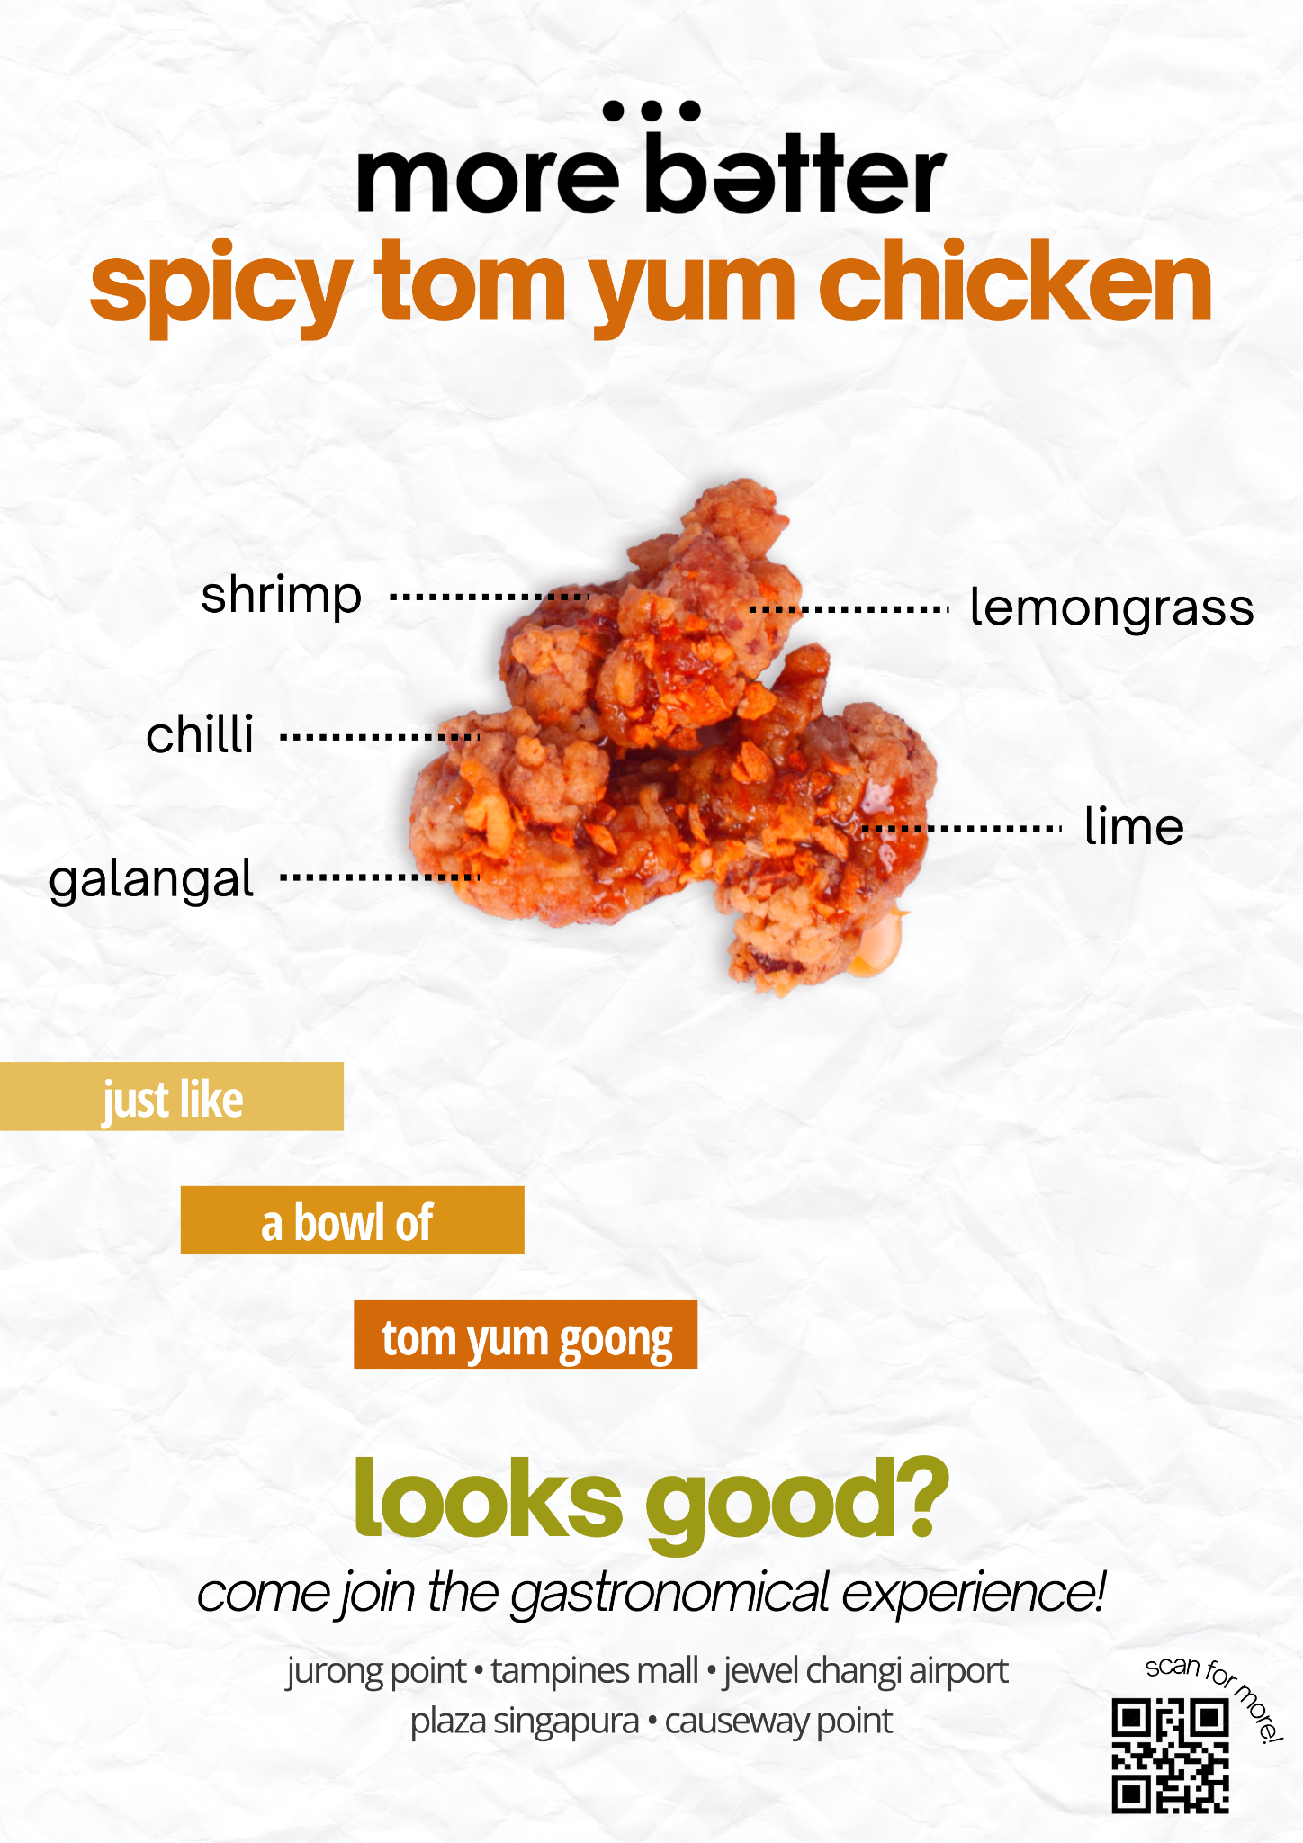
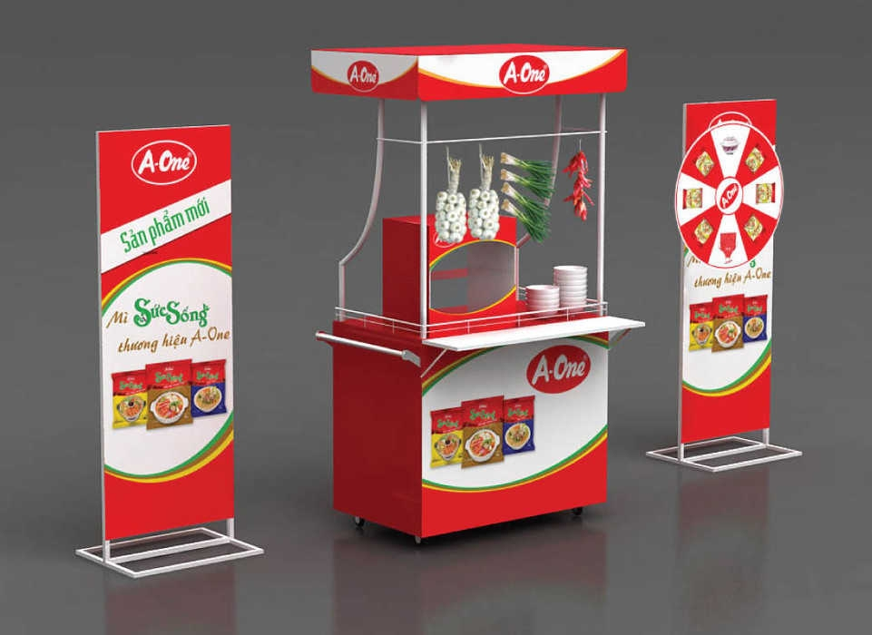
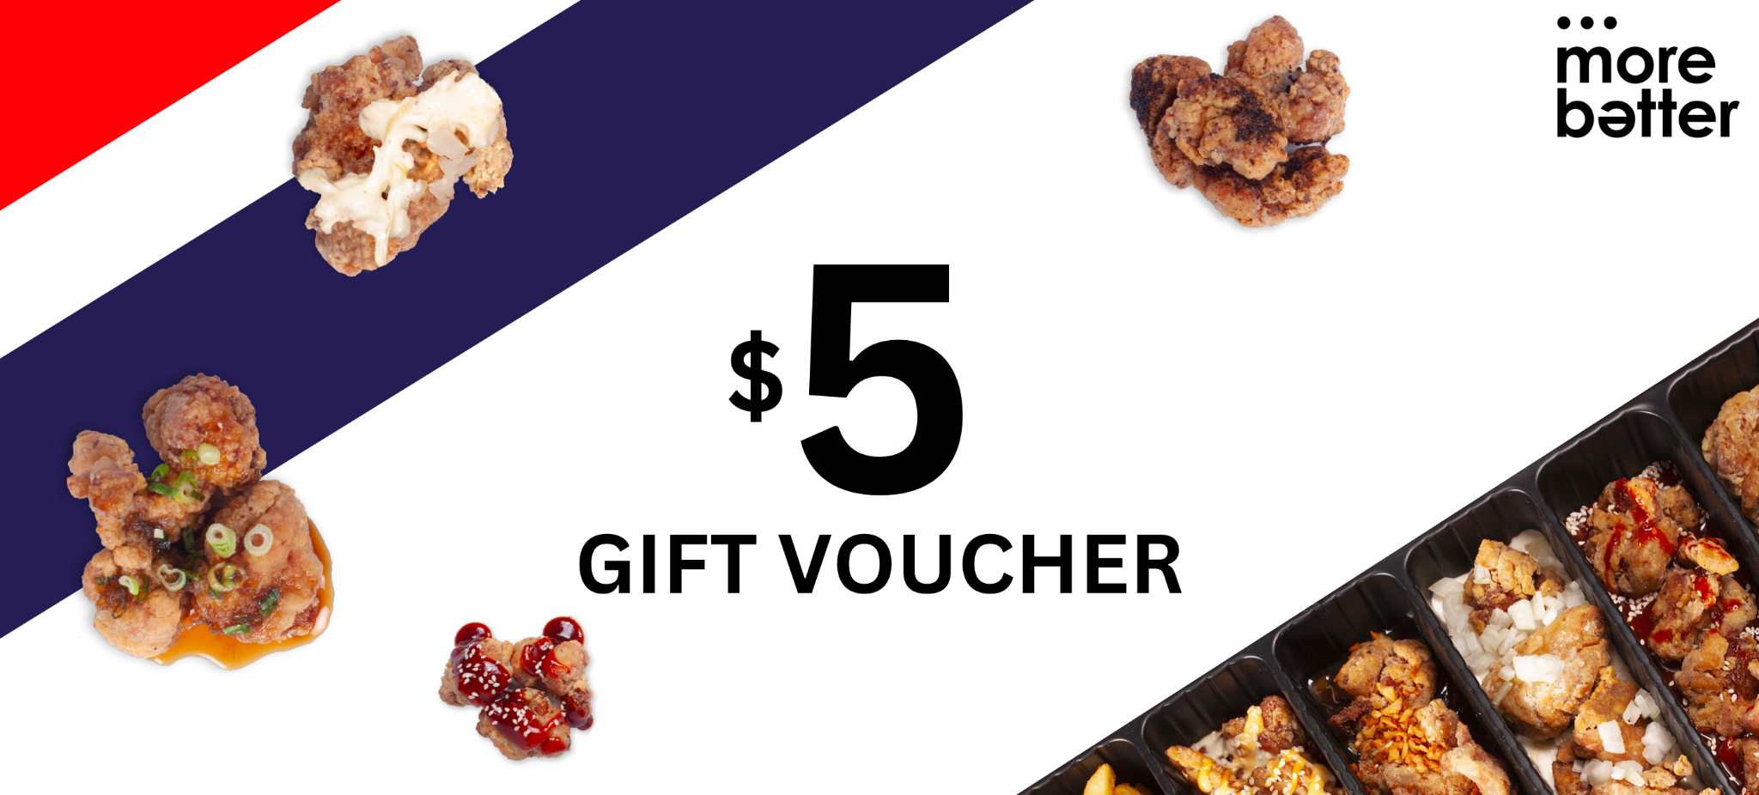
The Gastronomical Experience
Emcee
(Glenn Yong)
Gallery with
LED wall displays
Voucher Grabbing Machine
Egg Toss
Vouchers
Mascot
Samples Booth
IG Advertisements
Notes:
We will be conducting a pop-up exhibition at each of the mall locations selected. Aptly named “The Gastronomical Experience”, the pop-up exhibition would last for three months. It would allow customers to learn more about Thai history and cuisines. In addition, customers can engage in numerous interactive activities that would allow them to earn rewards. The pop-up would serve as an ideal venue for customers to take photos and post their experiences through various social media platforms, further increasing brand awareness and promotion.
Emcee: Glenn Yong
In order to promote More Batter’s presence, we will be hiring Singapore Mediacorp actor Glenn Yong, who has recently been rising in fame, to be our event host. His Instagram account boosts a total of 148k followers as of March 2023. He is the most suitable candidate who can help to increase awareness for More Batter since he has a personal fan account page called HangBaoBao, where fans will turn up for events that he is scheduled to be at. He will appeal to young Singaporeans who are also within the range of our target group. Hence, this would help to boost the turn up rate and create buzz.
Glenn will be gracing the stage every Sunday, from 12.00pm to 2.00pm, at one of the mall locations (which will be rotated every week). On stage, he will be providing fun facts on More Batter and Thai culture, giving regular updates on the pop-up activities available, and announcing the winners for the carnival activities listed below. His presence and popularity among young Singaporeans will serve to draw in crowds.
Gallery
A gallery of panels will be put up, with vivid descriptions and photos showcasing:
The history of various Thai regions;
The cultural significance of famous Thai cuisines such as Green Curry, Tom Yum, and Mango Sticky Rice (flavours we have adopted for the upcoming season); and
How More Batter sourced for ingredients to create an authentic taste for the fried chicken.
An LED screen will be mounted in the gallery, playing videos such as footages of Thai attractions, clips of Thai cuisines, and documentation of the More Batter food manufacturing process, allowing for a complete educational and sensory experience.
Carnival Activities
Several carnival-style activities listed below will be available for customers to participate in and potentially stand a chance to win rewards.
Egg Toss
Egg Toss is a game open on every Sunday where customers will stand 2 metres away and attempt to toss plastic eggs into the gaping mouths of the More Batter mascots. Customers would have to successfully toss in all three eggs into three openings in order to redeem a voucher for a free cup of Thai Milk Tea for their next online purchase.
Voucher Grabbing Machine
Customers will also get a chance to participate in the Voucher Grabbing Machine in order to stand a chance to win some discount codes for their next purchase from More Batter.
The Voucher Grabbing Machine will be open on the first Sunday of every month, at 12.00pm. It would be filled with 50 x “$5 off minimum spent $30” vouchers, as well as blank paper shreds. There will be a discount code written on the voucher itself so that participants can make use of it to get $5 off on their next purchase with a minimum spending of $30. These vouchers and paper shreds would be sent flying inside the interior of the machine once it is activated.
On each day, participants will enter the machine on a first-come-first serve basis. Participants will have 30 seconds to grab one voucher. There will be one participant at a time in the booth during each round. The papers and vouchers will be folded so that participants will not know what they will be grabbing. Hence, this game is entirely dependent on their luck.
Once the 50 vouchers have run out, this booth will close.
Mascot
Our mascot of Maurice, the More Batter Chicken will be walking around our event exhibition every Sunday, from 12.00pm to 6.00pm for customers to pose with and take photos or video shorts.
We will also be having 1 life-size mascot standee (dimensions of 100cm by 180cm) at each of our mall locations. Customers can pose for a picture or create a video short together with our mascot standee, and share the pictures and video shorts on social media platforms such as Instagram and TikTok. This would not only serve as an introduction to our brand icon, but also raise awareness of More Batter through user-generated content.
In addition, we will also be giving out vouchers for one free cup of Thai milk tea, in line with the launch of our Thai cuisine-inspired fried chicken. Customers will be entitled to a maximum of one voucher per person when they take a picture or video short with our mascot, Maurice or standee, and upload them on Instagram or Tiktok. Customers are to tag us on Instagram @morebattersg or TikTok @morebatter, with the hashtags #MoreBatterSG #TheGastronomicalExperience. Afterwards, our staff will verify the above steps before issuing them a voucher with a voucher code that can be used on any More Batter delivery platforms for their next purchase.
More Batter Samples Booth
During our physical exhibition, we will be having a pop-up booth that provides samples of More Batter fried chicken. These samples will include the original staples which More Batter already offers, as well as our newly launched Thai flavoured fried chicken.
Instagram Advertisements
To raise awareness of More Batter and promote The Gastronomical Experience, posters will be uploaded on the official More Batter Instagram page @morebattersg.
These posters are designed to be minimalistic to draw attention and entice viewers to find out more. It focuses on the ingredients that go into each specific Thai flavour – in this case, shrimp, lemongrass, chilli, lime, and galangal, key ingredients of Tom Yum Goong. Three different versions of posters will be uploaded to represent the three flavours of the Thai season (Green Curry, Tom Yum, and Mango Glazed). The 5 mall locations of The Gastronomical Experience, as well as a QR code that redirects to the More Batter website when scanned, will also be included on the poster.

Slide 19
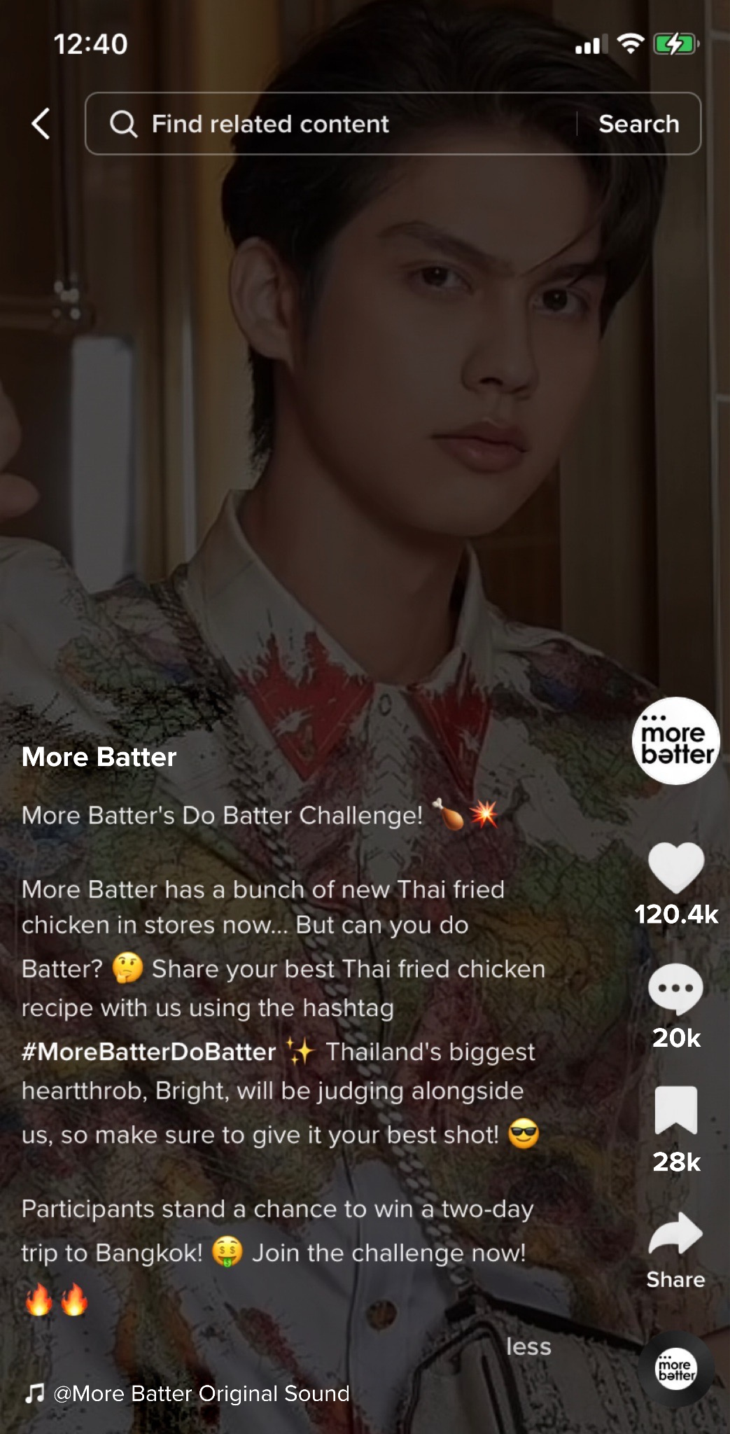
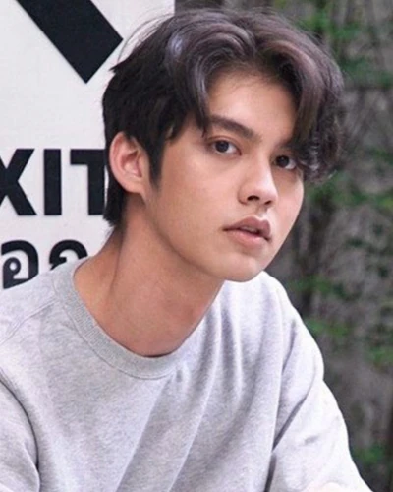
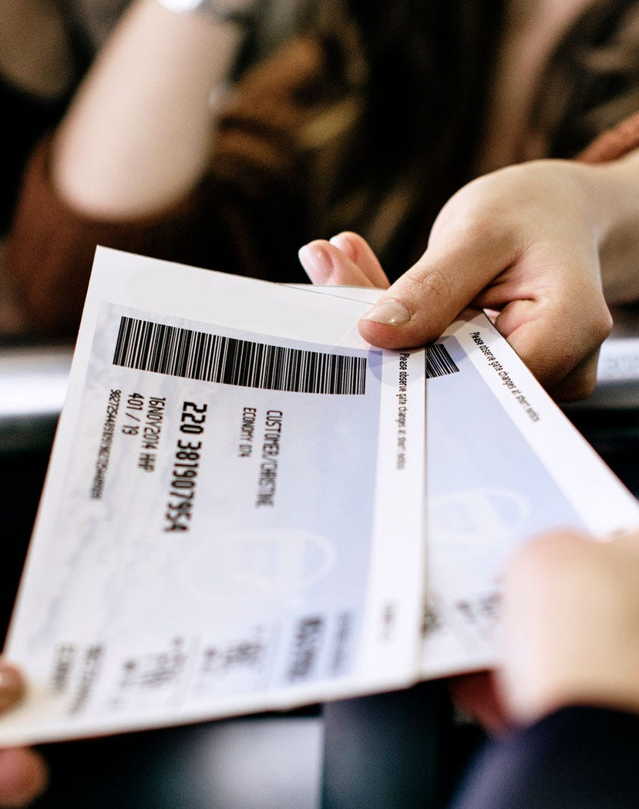
TikTok “Do Batter” Recipe Challenge
Influencer Spokesperson:
“Bright” Vachirawit
Thai Actor
Win Two-Way Plane Tickets to Bangkok, Thailand
Notes:
In tandem with The Gastronomical Experience, a TikTok Recipe Challenge named “Do Batter” will also be launched for three months as a social media marketing campaign.
Thai actor Vachirawit Chivaaree, better known as Bright, will be engaged as the spokesperson to represent this challenge. Starring in popular television series such as F4 Thailand: Boys Over Flowers and 2gether, his positive image and celebrity appeal among young Singaporeans and fans of Thai dramas will help to draw user traffic to our TikTok posts. This would allow More Batter to gain traction and brand awareness.
At the start of the challenge, Bright will appear in a post on More Batter’s TikTok page @morebatter to introduce the rules of the challenge as well as the prize. The following will be the caption to the TikTok post:
More Batter's Do Batter Challenge! 🍗💥
More Batter has a bunch of new Thai fried chicken in stores now... But can you Do Batter? 🤔 Share your best Thai fried chicken recipe with us using the hashtag #MoreBatterDoBatter ✨ Thailand's biggest heartthrob, Bright, will be judging alongside us, so make sure to give it your best shot! 😎
One lucky participant will stand a chance to win a two-way plane ticket to Bangkok! 🤑 Join the challenge now! 🔥🔥
After three months, one lucky winner with the best recipe will be selected based on these criteria:
Creativity - How unique is the recipe?
Informative - Are the recipe and the steps clear?
Authenticity - How close is it to Thai cuisine?
Presentation - Is the plating of the fried chicken eye-catching?
Engagement - Is the TikTok interesting and attention-grabbing?
At the end of the challenge, Bright will appear in another post on More Batter’s TikTok page to announce the name of the winner, congratulate them, and provide more details on the prize as well as the mode of collection of the prize.
Through this social media campaign, More Batter can seek to gain inspiration from the recipes posted by the users, and at the same time gather insights such as trends on popular fried chicken flavour profiles to make improvements and prepare for the next season.

Slide 20
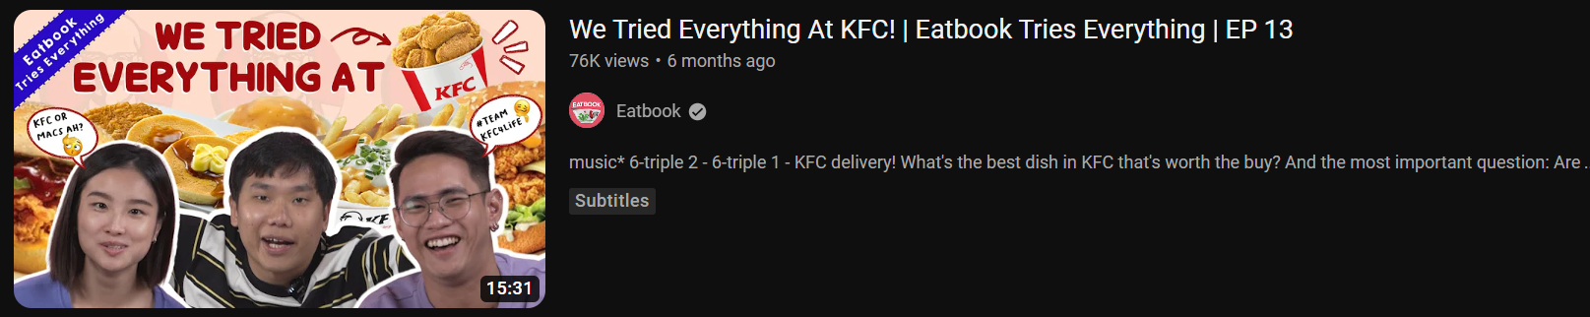
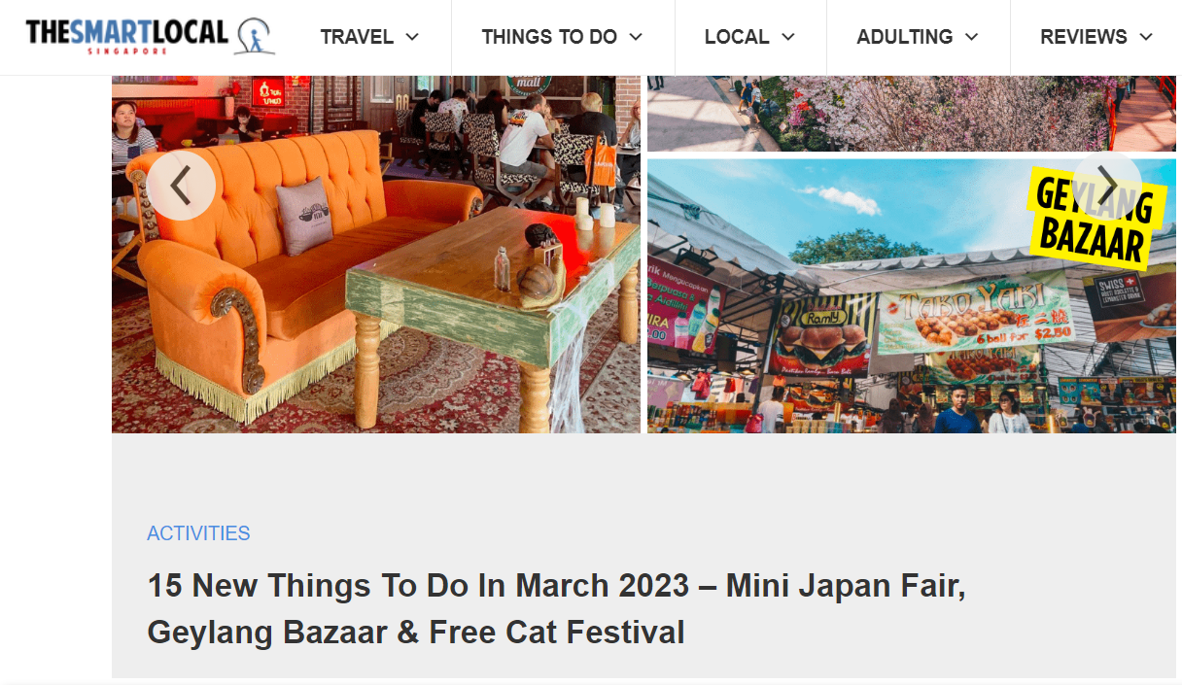

Collaboration with
TheSmartLocal and Eatbook
Eatbook Collaboration
TSL Collaboration
Notes:
We will be collaborating with TheSmartLocal and Eatbook for a mutually beneficial partnership.
TheSmartLocal
TheSmartLocal is a local media firm that publishes content on what to do in an out of Singapore, from a Singaporean perspective. Founded in 2012, it has amassed over 20 million pageviews on its blog website and 360,143 Instagram followers to date (TheSmartLocal, 2023).
For our collaboration with TheSmartLocal, we will be reaching out to them to request talent Fauzi Aziz to be the host, where he will be invited to The Gastronomical Experience to participate in the pop-up activities and try the fried chicken samples. In return, TheSmartLocal will post their experience on Instagram and write a review article on their blog website.
This would be a mutually beneficial collaboration as we provide TheSmartLocal with content for their blog website and Instagram page, while gaining promotion and traction for the brand. TheSmartLocal is an ideal partner for collaboration as all their reviews are written by locals from an “informed and accurate local perspective of a country”. They implement a stringent moderation policy to detect fake reviews effectively. On top of other credibility indicators to ensure integrity of content, all reviews are thoroughly vetted before they are posted (Canon Singapore, n.d.). This reflects their commitment to making quality content for viewers.
Eatbook
Eatbook (a brand by TheSmartLocal) is a popular local food and lifestyle network that offers a variety of content related to dining and food culture. It has been in the YouTube scene since 2013, amassing over 140,000 subscribers and over 65 million views to date (Eatbook, 2023). One popular series on their channel is Eatbook Tries Everything, where talents will try every food or menu item of a particular store or brand, giving their thoughts on the taste.
For our collaboration with Eatbook, we will be inviting the Eatbook Team alongside with talent Chiara as the host to film a video on “Eatbook Tries Everything at More Batter”. We will be sponsoring the food eaten by them entirely with no limits during the shooting day itself. In return, Eatbook will create a video (minimum 10 minutes in length) and put it up on their YouTube channel. The video will be on More Batter’s fried chicken and feature the newly launched Thai chicken flavours and sides offered.
This would be a mutually beneficial collaboration as we provide Eatbook with free food and content for their YouTube Channel, while the good reviews featured in the video will incentivise viewers to purchase the fried chicken for themselves to try. As a brand promotion tool, Eatbook can be effective in reaching a large audience of food lovers in Singapore and providing exposure for food-related businesses like More Batter.
Collaboration Details
This will be a partnership where an invitation will be extended to TheSmartLocal and Eatbook for collaboration. As such, the cost incurred would solely be on the production cost of the chicken, sides, and drinks that will be consumed by both of our key partners.
TheSmartLocal. (2023) About us. https://thesmartlocal.com/aboutus/
Canon Singapore. (n.d.) TheSmartLocal: Doing as the Locals Do (Part 1). https://sg.canon/en/campaign/business-insight/interview-with-clients/thesmartlocal-doing-as-the-locals-do-part-1
Eatbook. (2023) About. YouTube. https://www.youtube.com/@EatbookYT/about

Slide 21
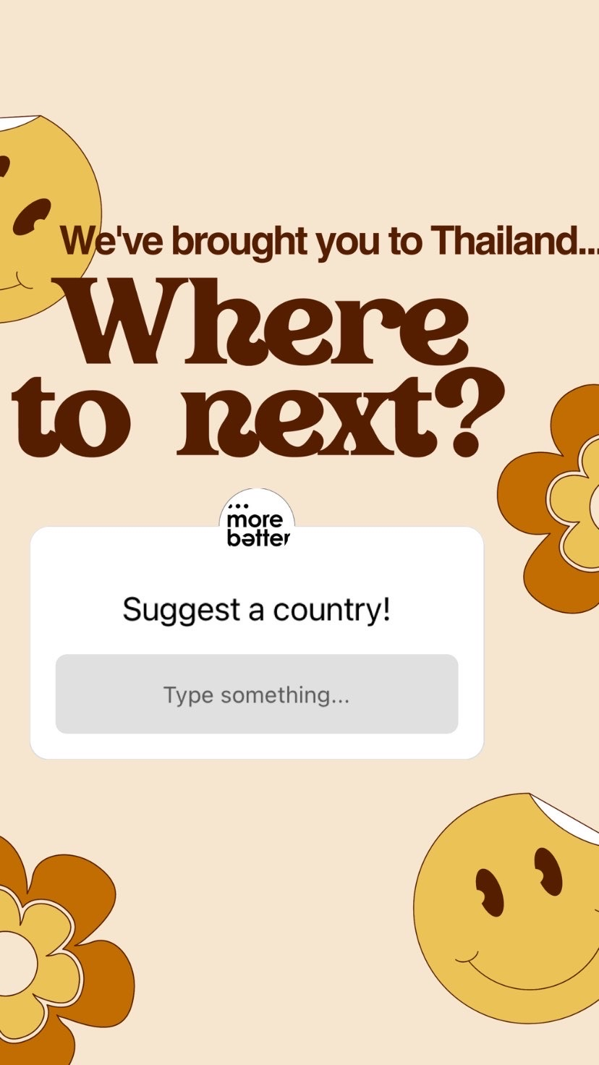
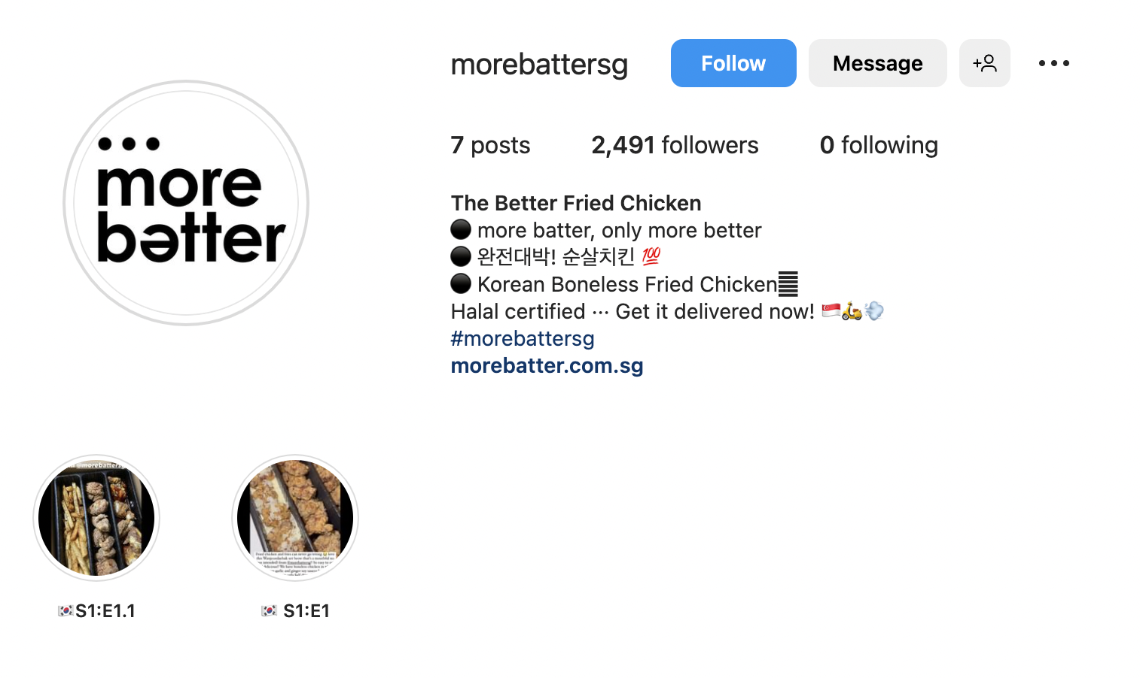
Instagram Poll: Where to next?
Notes:
At the end of the marketing campaign, an open-ended poll will be posted as an Instagram story on More Batter’s official Instagram page @morebattersg, with the following captions:
We’ve brought you to Thailand,
Where to next?
Suggest a country!
The poll serves to gather feedback on the country themes customers hope More Batter would embark on moving forward. This closes the loop for the marketing campaign as More Batter prepares for the next season.

Slide 22
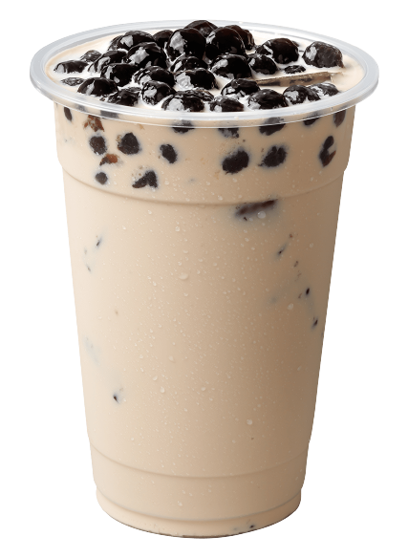
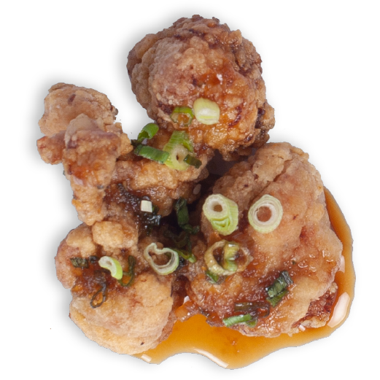
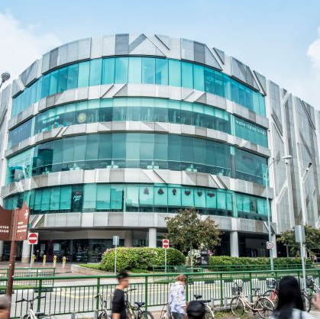
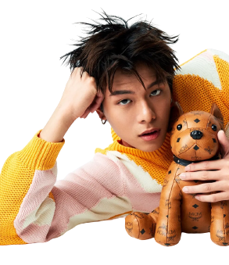
Cost of Implementation: The Gastronomical Experience
FOC Chicken and Milk Tea
Production costs incurred under Operating Cost for fried chicken samples and free Thai milk tea
Event Space
Exhibition size projected to be 600 square feet
Projected cost for 3,000 square feet across the
five malls is $90,000
(Seth Lui, 2013)
Mascot
Hourly rate of S$20 - 30 (SG Observer, n.d.)
Basic costume cost of S$478.17 each (Murat, n.d.)
Life-size mascot standee at S$78.70 each (Botak Sign, n.d.)
Micro-Influencer
Glenn Yong will host every Sunday from 12.00pm to 2.00pm (2 hours)
Cost of hiring Glenn Yong is
estimated to be $175/hour (SGEMCEE.COM, 2023)
Gallery Panels and Projector
S$8,250 for gallery panels
S$10,000 for LED screens
Vouchers
$3,750 worth of vouchers given out during the event at 5 different locations for the “Voucher Grabbing Machine”
Game Rental
Machines will be rented for a total of 3 months, every Sunday
S$7,250 for “Egg Toss”
S$11,250 for “Voucher Grabbing Machine
(The Carnival Fair SG)
Total Cost:
S$146,484.35
Notes:
Cost of Implementation
Mascot
Based on our research, we found that the cost of hiring people to be in a mascot costume would cost S$20 - 30 per hour (S$25 per hour on average) (SG Observer, n.d.). Since we will be having 1 mascot each in our 5 mall locations, we will hire up to 5 people for the job. Our mascot will be walking around our event exhibition every Sunday from 12.00pm to 6.00pm, and this would last for a total of 3 months. Thus, the expenses incurred for hiring would be 6 hours x 4 Sundays x 3 months x 5 locations x S$25 = S$9,000.
In addition, according to a listing on Etsy, the cost for a custom-made mascot costume is S$478.17 (Prices may fluctuate) (Murat, n.d.). Since we will be having a total of 5 mascots across our 5 different mall locations, the total cost for the costumes will be 5 costumes x S$478.17 = $2,390.85.
We will also be having 1 life-size mascot standee (dimensions of 100cm by 180cm) at each of our mall locations. The total printing cost incurred as seen from Botak Sign is 5 locations x S$78.70 = S$393.50 (Botak Sign, n.d.).
Thus, the total costs incurred with the usage of our mascots is S$9,000 + S$2390.85 + S$393.50 = $11,784.35.
Fried Chicken Samples and Free Thai Milk Tea Redemption
As these are part of food production costs, they will be accounted for under Operating Cost.
Micro-Influencer: Glenn Yong
According to SGEMCEE.COM, the ballpark estimates provided for a roadshow emcee is S$100 - 250 per hour (S$175 per hour on average) (SGEMCEE.COM, 2023).
Since we will be hiring Mediacorp actor Glenn Yong to host the event every Sunday from 12pm - 2pm (2 hours), the total cost will be 2 hours x 4 Sundays x 3 months x S$175 = S$4,200.
Voucher Budget
The total value of the “$5 off minimum spent $30” vouchers that will be put inside the Voucher Grabbing Machine would be 50 vouchers x 5 locations x 3 months x S$5 = S$3,750.
Game Rental: Egg Toss
Based on The Carnival Fair SG, the vendor which we have contacted directly, we found that the cost of renting the Egg Toss game will be S$100 nett per day. An additional S$250 will be incurred for customisation of the game design to include our mascot. Since we will be having the game every Sunday for a total of 3 months, the total cost will be (4 Sundays x 3 months x 5 locations x S$100) + (S$250 x 5 locations) = S$7,250.
Game Rental: Voucher Grabbing Machine
Based on The Carnival Fair SG, the vendor which we have contacted directly, we found that the cost of renting an Inflatable Cash Flow machine (Voucher Grabbing Machine) will be $750 nett per day. Since we will be having the machine every Sunday of the first month, the total cost will be 3 months x 5 locations x S$750 = S$11,250.
Space Rental Cost
We estimate that the exhibition would take up 600 square feet per mall location. An estimated rental rate of S$30 per square foot was provided by Seth Lui for malls under Capitamalls, which most of our mall locations fall under (Tampines Mall, Jewel Changi Airport, and Plaza Singapura) (Seth Lui, 2013). The specific locations used would be Jurong Point’s Event Hall on Level 3, Tampines Mall’s Event Hall on Level 4, the Jewel Atrium on Basement 1, Plaza Singapura’s Event Hall on Level 1, and Causeway Point’s Event Hall on Level 2. The total space rental cost comes out to be 600sqft x 5 locations x S$30 = S$90,000 for a total of 3,000 square feet across the 5 locations.
This figure is, of course, an estimated one. It is up to More Batter’s discretion to negotiate with the respective mall managements on the cost, as well as whether or not they want to utilise the figure of 600 square feet for each exhibition.
Gallery Panels and LED Screen
According to Tentage Rental Singapore, the rental cost of exhibition display panels costs S$45 monthly, with a setup and dismantle fee of S$300 (Tentage Rental Singapore, n.d.). We will be renting 10 boards per location to display the information required.
Hence, the total cost would be (3 months x 5 locations x 10 boards x S$45) + (5 locations x S$300) = S$8,250.
For the LED screens, the rental cost will be S$2,000 per panel based on Carousell (AV Solution, 2023). Since we will be having 1 gallery panel per location, the total cost will be 5 locations x S$2000 = S$10,000 for a total of 3 months.
Total Cost
As such, the total cost for The Gastronomical Experience is S$146,484.35.
SG Observer. (n.d.) 10 High Paying Part-Time Jobs in Singapore That Pay the Best. https://www.sgobserver.com/high-paying-part-time-jobs-singapore/#:~:text=A%20Mascot%20is%20a%20Part%2DTime%20Job%20that%20Pays%20Quite%20Well&text=You%20can%20expect%20to%20earn%20an%20hourly%20rate%20of%20%2420,do%20all%20those%20funny%20antics
Murat. (n.d.) Any Mascot Costume You Want. Etsy. https://www.etsy.com/sg-en/listing/1204222247/any-mascot-costume-you-want?ga_order=most_relevant&ga_search_type=all&ga_view_type=gallery&ga_search_query=mascot+costume+custom&ref=sc_gallery-1-1&frs=1&plkey=b4cf125109b42ad7e8abf40a7f9c266c018eb21b%3A1204222247
Botak Sign. (n.d.) Life Size Standee. https://botaksign.com/product/life-size-standee/
SGEMCEE.COM. (2023) [Updated 2023] Singapore Emcee Rates and Charges for Different Types of Events. https://sgemcee.com/singapore-emcee-rates-and-charges-for-different-genre-of-events/
Lui, S. (2013) Guide to Rental Rates in A Shopping Mall in Singapore. SethLui.com. https://sethlui.com/rental-rates-shopping-mall/
Tentage Rental Singapore. (n.d.) Exhibition Panel Boards. https://www.tentagerentalsingapore.com/exhibition-panel-boards/
AV Solution. (2023) Shop front led screen led wall digital led videowall installation led screen maintenance, Retail store led advertisement screen, video content management system, LED Digital Screen Expert. Carousell. https://www.carousell.sg/p/shop-front-led-screen-led-wall-digital-led-videowall-installation-led-screen-maintenance-retail-store-led-advertisement-screen-video-content-management-system-led-digital-screen-expert-1155882946/?t-id=4204697_1679663589399&t-referrer_browse_type=search_results&t-referrer_context=global_slp&t-referrer_request_id=UTyYiSpzWumfJhq-&t-referrer_search_query=led%20display%20panel&t-referrer_source=search_landing&t-tap_index=1

Slide 23


Projected Outcome: The Gastronomical Experience
TURN-UP
Approximately 20,000 people
80% RETURN
REVENUE OF
S$192,000
16,000 new customers from voucher codes
16,000 x S$12
Notes:
Projected Outcome
Expected Turn-up, Sales Generated, and Revenue
For the entire event, we estimate that there will be a turn-up of approximately 20,000 people.
Since customers who obtained the voucher codes will visit More Batter in order to spend their vouchers, and more people would have been aware of More Batter, we expect 80% of these customers (16,000 customers) will return to patronise the brand.
Assuming that these 16,000 customers purchase one of the fried chicken sets from the Thai season (S$12 each), we can expect a revenue of 16,000 sets x S$12 = S$192,000 in total, resulting from the marketing efforts of The Gastronomical Experience.

Slide 24
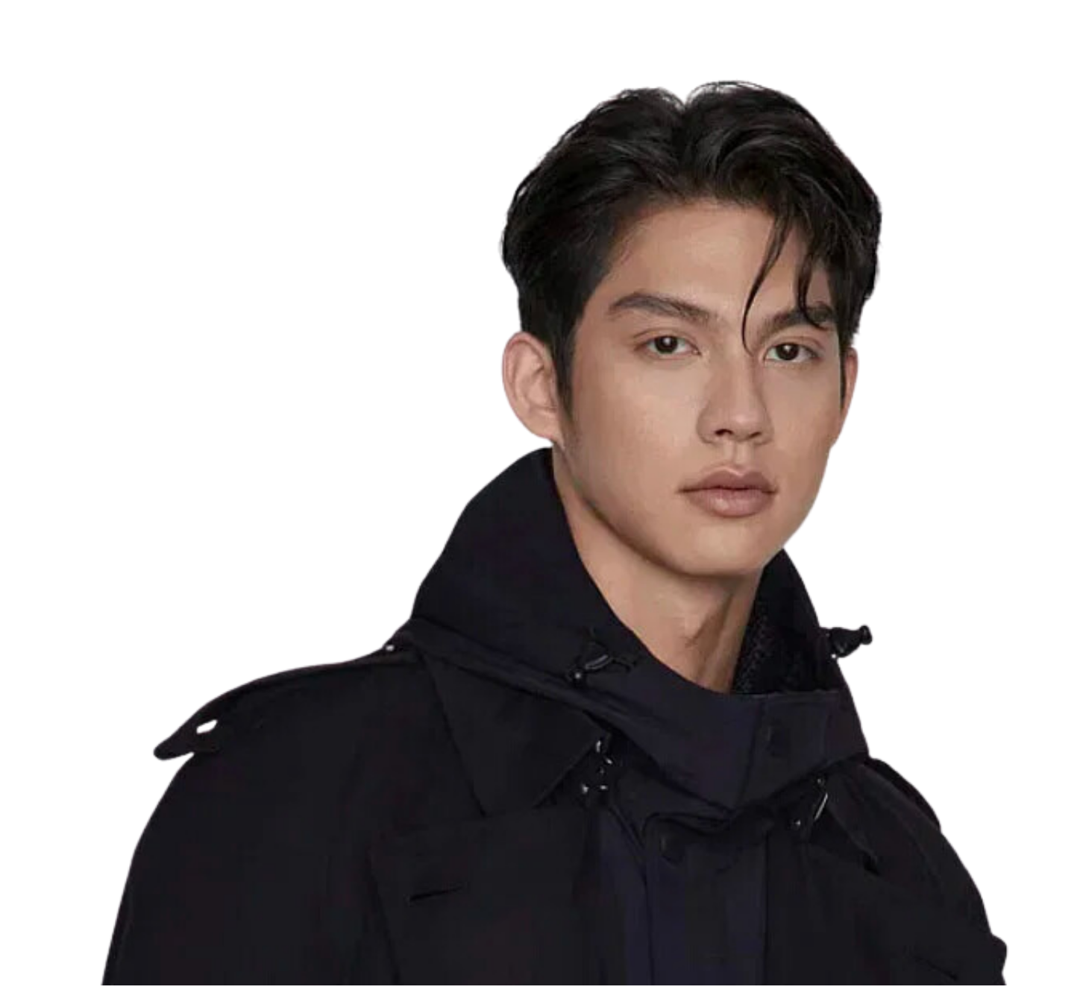

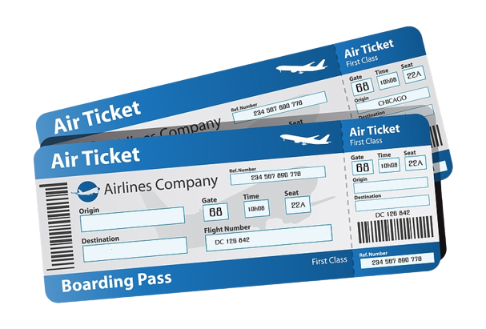
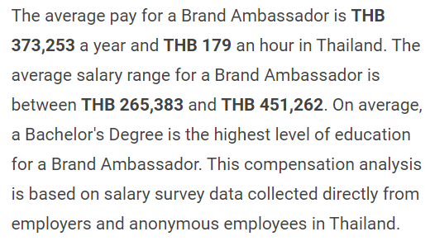
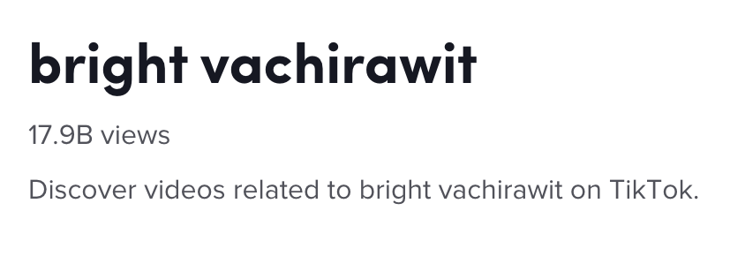
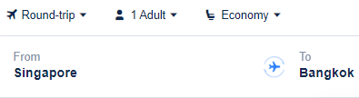

Financial Viability and Projected Outcome: Do Batter
Brand Ambassador Fees
Brand Ambassador: BRIGHT
Round Trip Plane Ticket to BANGKOK
VIEWERSHIP AND ENGAGEMENT
For peak seasons, the estimated cost for the plane ticket will be S$155.
For off-peak seasons, the estimated cost of the plane ticket will be $123.25.
Cost of the plane ticket is taken from Trip.com, on the 15th of every month.
30,000 likes on each TikTok post
24,000 TikTok posts under the hashtag #MoreBatterDoBatter
Gain an additional 15,000 followers on TikTok
Fig 1: Economic Research Institute
Fig 2: Tiktok
For our lucky Tiktok challenge winner!
Fig 2: BusinessofApps
Notes:
Cost of Implementation
Brand Ambassador: Bright Vachirawit
We are proposing to hire Vachirawit Chivaaree, better known as Bright, for the face of More Batter in line with our upcoming launch of Thai-flavoured fried chicken. As seen from Fig. 1, the Economic Research Institute states that the average cost for a Thai Brand ambassador would be THB 372,542 (Economic Research Institute, n.d.). This is an estimated cost of S$14,467.
In the long run, the benefits of making use of a brand influencer would be greater than its costs. Influencer marketing is a good strategy to leverage in order to reach a larger group of audience. The biggest selling point would be with regards to the attractiveness of the celebrity. Since we are proposing to use Bright, he would enable instant brand awareness due to his immense popularity on TikTok with 17.9 billion views attributed to his name (as seen from Fig. 2) (TikTok, 2023), enabling us to attain a huge customer reach. Celebrities significantly increase brand recognition and boost brand profits. Bright’s value will attract customers and energise More Batter’s image. Customers often remember brands by the name of the celebrities who endorse the brand. Hence, using Bright as our celebrity endorsement leaves a lasting impression on our marketing campaign, allowing customers to associate a positive image with the brand as they have on the celebrity.
Plane Ticket
The cost of the plane ticket awarded to the challenge winner is taken from Trip.com, on the 15th of every month (Trip.com, n.d.).
For peak seasons during March holidays, June holidays and November to December holidays, the cost of a plane ticket to Bangkok will be S$170, S$130, S$140, and S$180 respectively for the individual periods. By taking the average cost, the approximate cost of the plane ticket will be (S$170 + S$130 + S$140 + S$180)/4 = S$155.
For off-peak seasons during the rest of the other months, the cost of the plane ticket will be on average (S$110 + S$140 + S$120 + S$118 + S$98 + S$110 + S$140 + S$150)/8 = $123.25.
Projected Outcome
Viewership and Engagement
Based on Bright’s popularity in Singapore, it is expected that his influence will be impactful in attracting people to participate in our TikTok challenge. Bright has a total number of 17.6 million Instagram followers as of March 2023, and he was previously invited as a guest for YSL Beauty Libre Pop-up on 22 March 2023 at ION Orchard. His appearance gathered hordes of fans who waited patiently, hoping to catch a glimpse of him (Cambe, 2023). Thus, we can estimate that by using Bright as More Batter’s brand ambassador, we can achieve similar results.
The TikTok challenge, which gives participants a chance to win a round trip plane ticket to Bangkok, will help More Batter to increase brand awareness and also generate user content. It is estimated that there will be 30,000 likes for each TikTok post from Bright on More Batter’s TikTok page @morebatter. Out of the 30,000 viewers who liked the post, it is estimated that 80% of them (24,000 participants) will participate in the TikTok challenge, as the steps are relatively straightforward to follow in order to stand a chance to win tickets. This means that we can expect 24,000 TikTok posts under the hashtag #MoreBatterDoBatter. In addition, we estimate that 50% of the 30,000 users (15,000 followers) will follow our TikTok page. This means that More Batter can expect to gain an additional 15,000 followers on TikTok from this challenge.
The above figures are just an estimated sum. Since Bright has a very large fan base, it is expected that there will be a greater number of people participating in the Tiktok challenge, which will help to boost More Batter’s reputation.
Economic Research Institute. (n.d.) Brand Ambassador Salary in Thailand. https://www.erieri.com/salary/job/brand-ambassador/thailand
TikTok. (2023) bright vachirawit. https://www.tiktok.com/discover/bright-vachirawit?lang=en
Trip.com. (n.d.) Flights to Bangkok. https://sg.trip.com/flightsem/flight/dest?city=bkk
Cambe, P. (2023) Bright Vachirawit steals the show at YSL Beauty’s Libre pop-up in Singapore. Tatler Asia. https://www.tatlerasia.com/style/beauty/bright-vachirawit-ysl-beauty-libre-pop-up-ion-orchard-singapore-celebrities-photos

Slide 25
Thank you!

Slide 26
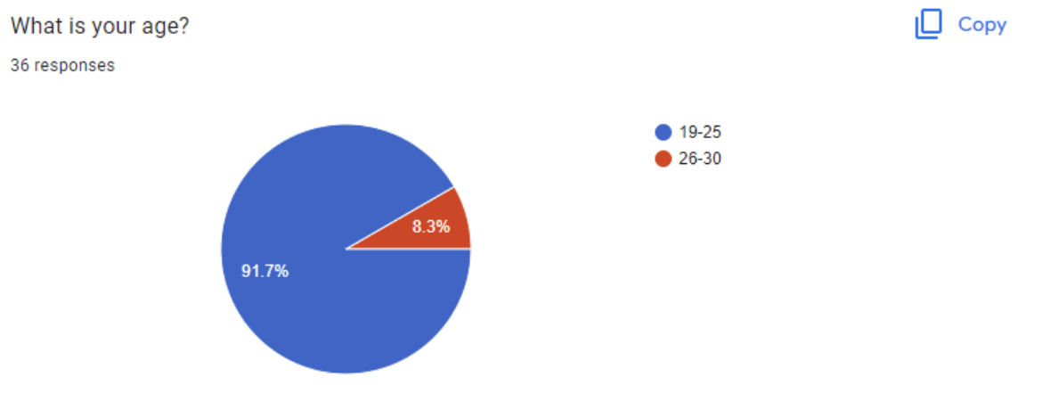
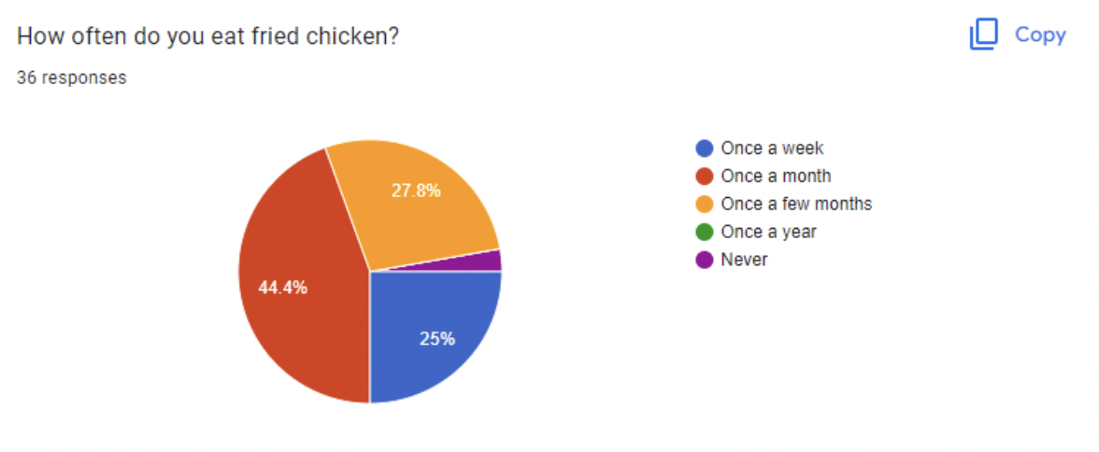
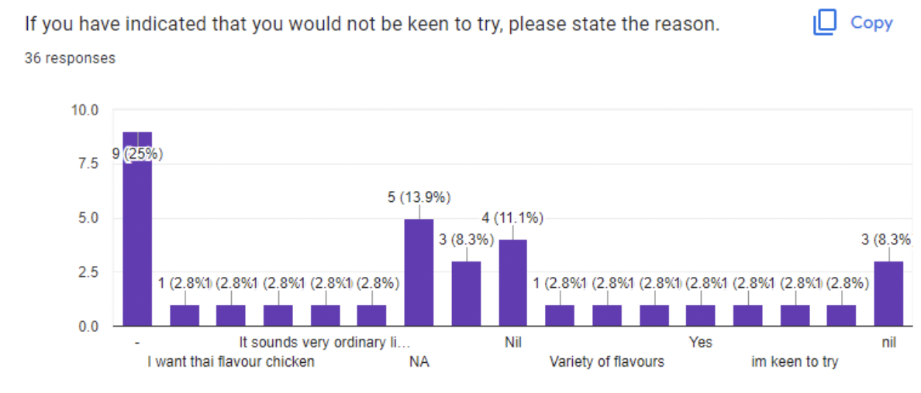
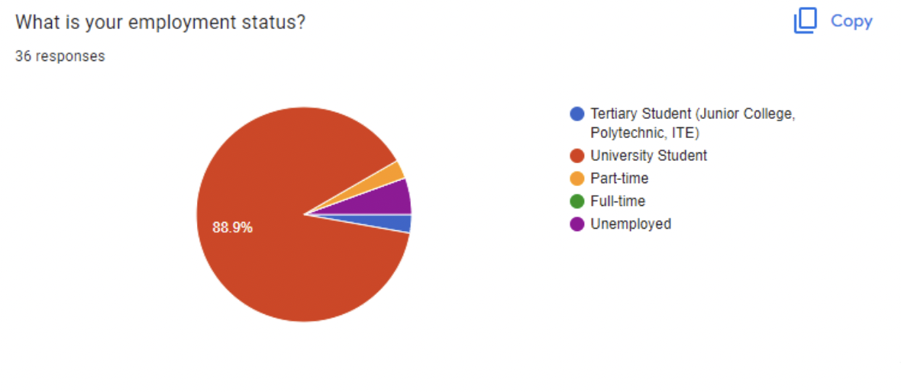
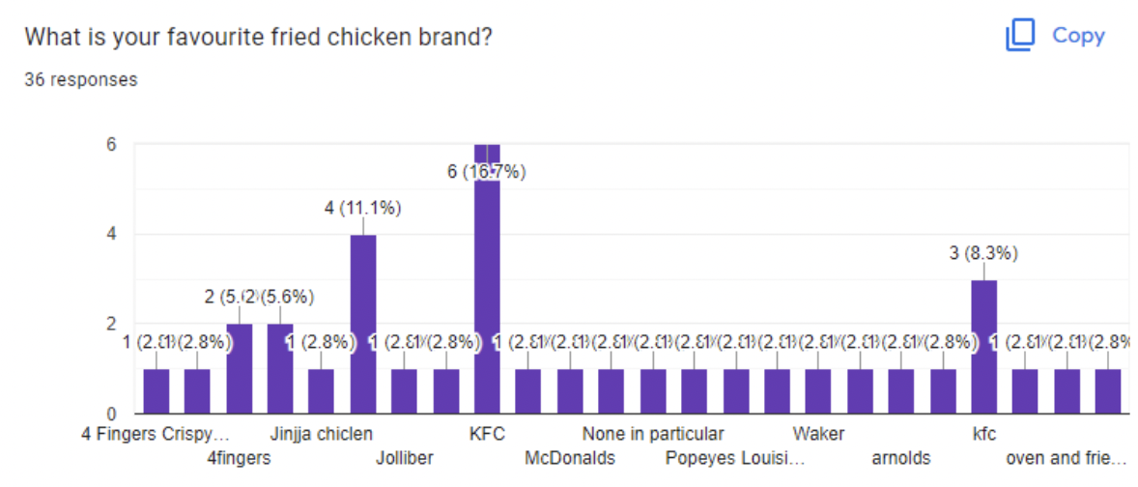
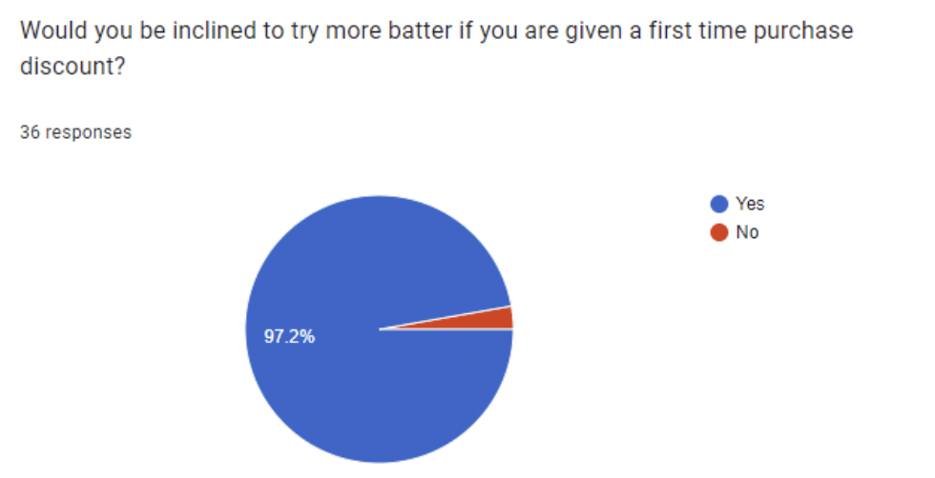






ANNEX: SURVEY RESULTS
Notes:
PDF link to survey results: https://drive.google.com/file/d/1kSeraykiMxFhWscSv2PpwBL73s0prIIG/view?usp=sharing
Google Sheet with individual responses: https://docs.google.com/spreadsheets/d/1uTkt313WTIdjYLK2R4gAiWbzRC-k3uRgzX9VQhIa9ZA/edit?usp=sharing

Slide 27
References:
4Fingers Pte. Ltd. (2023) https://www.4fingers.com.sg/
Admin, I. (2023, March 3). Celebrity Endorsement vs. Influencer Marketing in Thailand. Influencer House. https://www.influencerhouse.co.th/celebrity-endorsement-vs-influencer-marketing-in-thailand/
AV Solution. (2023) Shop front led screen led wall digital led videowall installation led screen maintenance, Retail store led advertisement screen, video content management system, LED Digital Screen Expert. Carousell. https://www.carousell.sg/p/shop-front-led-screen-led-wall-digital-led-videowall-installation-led-screen-maintenance-retail-store-led-advertisement-screen-video-content-management-system-led-digital-screen-expert-1155882946/?t-id=4204697_1679663589399&t-referrer_browse_type=search_results&t-referrer_context=global_slp&t-referrer_request_id=UTyYiSpzWumfJhq-&t-referrer_search_query=led%20display%20panel&t-referrer_source=search_landing&t-tap_index=1
Botak Sign. (n.d.) Life Size Standee. https://botaksign.com/product/life-size-standee/
Cambe, P. (2023) Bright Vachirawit steals the show at YSL Beauty’s Libre pop-up in Singapore. Tatler Asia. https://www.tatlerasia.com/style/beauty/bright-vachirawit-ysl-beauty-libre-pop-up-ion-orchard-singapore-celebrities-photos
Canon Singapore. (n.d.) TheSmartLocal: Doing as the Locals Do (Part 1). https://sg.canon/en/campaign/business-insight/interview-with-clients/thesmartlocal-doing-as-the-locals-do-part-1
Commission Factory. (2023) Singapore Social Media Statistics and Facts 2023. https://blog.commissionfactory.com/affiliate-marketing/singapore-social-media-statistics
Eatbook. (2023) About. YouTube. https://www.youtube.com/@EatbookYT/about
Economic Research Institute. (n.d.) Brand Ambassador Salary in Thailand. https://www.erieri.com/salary/job/brand-ambassador/thailand
KFC Singapore. (2021) https://www.kfc.com.sg/
Khoo, H. Chatuchak Night Market Singapore returns with 180 stalls on Feb 7. The Straits Times. https://www.straitstimes.com/life/food/chatuchak-night-market-singapore-returns-with-180-stalls-on-feb-7
Lui, S. (2013) Guide to Rental Rates in A Shopping Mall in Singapore. SethLui.com. https://sethlui.com/rental-rates-shopping-mall/
MapleTree Media. (n.d.) Singapore Social Media Statistics You Should Know Of. https://mapletreemedia.com/singapore-social-media-statistic/
Ministry of Education. (2022) Education Statistics Digest 2022. https://www.moe.gov.sg/-/media/files/about-us/education-statistics-digest-2022.ashx
More Batter. (2023) https://morebatter.com.sg/

Slide 28
References:
Murat. (n.d.) Any Mascot Costume You Want. Etsy. https://www.etsy.com/sg-en/listing/1204222247/any-mascot-costume-you-want?ga_order=most_relevant&ga_search_type=all&ga_view_type=gallery&ga_search_query=mascot+costume+custom&ref=sc_gallery-1-1&frs=1&plkey=b4cf125109b42ad7e8abf40a7f9c266c018eb21b%3A1204222247
Rahmad (2023). Average Salary in Singapore by Age, Experience and Education Level. Workclass. https://workclass.co/singapore/blogs/average-salary-in-singapore-by-age-and-experience/
SG Observer. (n.d.) 10 High Paying Part-Time Jobs in Singapore That Pay the Best. https://www.sgobserver.com/high-paying-part-time-jobs-singapore/#:~:text=A%20Mascot%20is%20a%20Part%2DTime%20Job%20that%20Pays%20Quite%20Well&text=You%20can%20expect%20to%20earn%20an%20hourly%20rate%20of%20%2420,do%20all%20those%20funny%20antics
Singapore Department of Statistics (2020). Census of Population 2020 Statistical Release 2: Households, Geographic Distribution, Transport and Difficulty in Basic Activities. https://www.parliament.gov.sg/docs/default-source/default-document-library/cop2020sr2.pdf
Singapore Department of Statistics (2022). Total Residents Aged 15 Years And Over By Labour Force Status And Age Group, End June. https://tablebuilder.singstat.gov.sg/table/TS/M182091
Tan, A. Thai pop is on the rise—here are 5 artists to know of. Vogue Singapore. https://vogue.sg/thai-pop-artists-to-know/
Teo, M. 'Extremely ridiculous': Man warns of 3-hour waiting times at Chatuchak Singapore as event draws massive crowds. AsiaOne. https://www.asiaone.com/singapore/extremely-ridiculous-man-warns-3-hour-waiting-times-chatuchak-singapore-event-draws
Tentage Rental Singapore. (n.d.) Exhibition Panel Boards. https://www.tentagerentalsingapore.com/exhibition-panel-boards/
TheSmartLocal. (2023) About us. https://thesmartlocal.com/aboutus/
TikTok. (2023) bright vachirawit. https://www.tiktok.com/discover/bright-vachirawit?lang=en
Trip.com. (n.d.) Flights to Bangkok. https://sg.trip.com/flightsem/flight/dest?city=bkk
Wingstop Restaurants, Inc. (2023) https://www.wingstop.com.sg/

